Slide 1
Headwaters District Roundtable
October 1st 2020

Slide 2
PLEASE BE RESPECTFUL
We will provide everyone a chance to talk and ask questions. Please mute your microphone during discussions to help cut down on background noise.

Slide 3
Please sign in
It helps us understand how we are doing and how we can improve your experience.
https://forms.gle/XQaU3T4TJ8jaQCru6

Slide 4
Welcome to our Virtual Roundtable
Agenda
Council Key 3
Rechartering
Journey to Excellence
Youth Protection Training
Cub Scout/Scouts BSA breakout

Slide 5
Welcome to our Council Key 3
They are here to answer questions from you, our district, and unit leaders who daily are involved with the youth we serve.

Slide 6
Unit Rechartering
Packets are available starting tonight! 10/01/20
Your unit key 3 should meet and work together to complete the paperwork.

Slide 7
Unit Rechartering
This is a year round planning event ,you will need lots of information such as
Which youth are continuing with the program and the unit? Which youth are leaving the unit?
Which leaders are staying?
What positions do we need to recruit volunteers
etc…

Slide 8
Unit rechartering resources
Mayflower.org
https://www.mayflowerbsa.org/resources/unit-management/internet-rechartering/
Scouting.org
https://i9peu1ikn3a16vg4e45rqi17-wpengine.netdna-ssl.com/wp-content/uploads/2019/11/Internet-Rechartering-Update_Version_11_August2020.pdf

Slide 9
Unit Rechartering
Paperwork review sessions.
Need to leverage technology this year.
In person review sessions not practical this year.
Commissioners happy to work with scanned/photographed paperwork.
Zoom calls to review.

Slide 10
Unit Rechartering
Paperwork hand in
Can be mailed to council, but only after it has been reviewed for completeness.
A scout is kind.
We need to be kind to our District Exec!

Slide 11
Journey to Excellence (JTE)
This is a tool for the unit to use to gauge your program.
You will have a better program for the youth by focusing on continuous unit improvement
It is not used by the district and council to rank units
Be honest with answers
Update regularly

Slide 12
Journey to Excellence (JTE)
Forms have been updated for 2020
https://www.scouting.org/awards/journey-to-excellence/unit/2020-scorecards-english/

Slide 13
Youth protection Training YPT
You are responsible in tracking your unit training requirements.
Almost everyone needs to renew YPT in the next few months
New YPT came out in 2018
Most leaders took in the fall of 2018
All adults must have current YPT to recharter

Slide 14
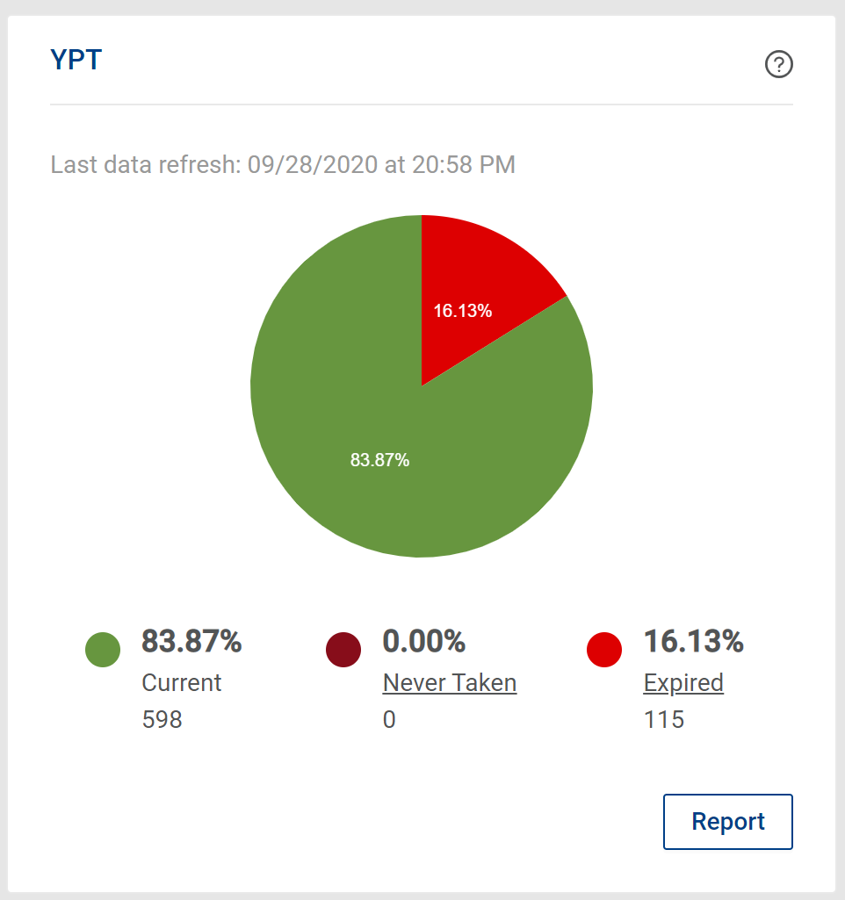
YPT as of 9/28/2020

Slide 15
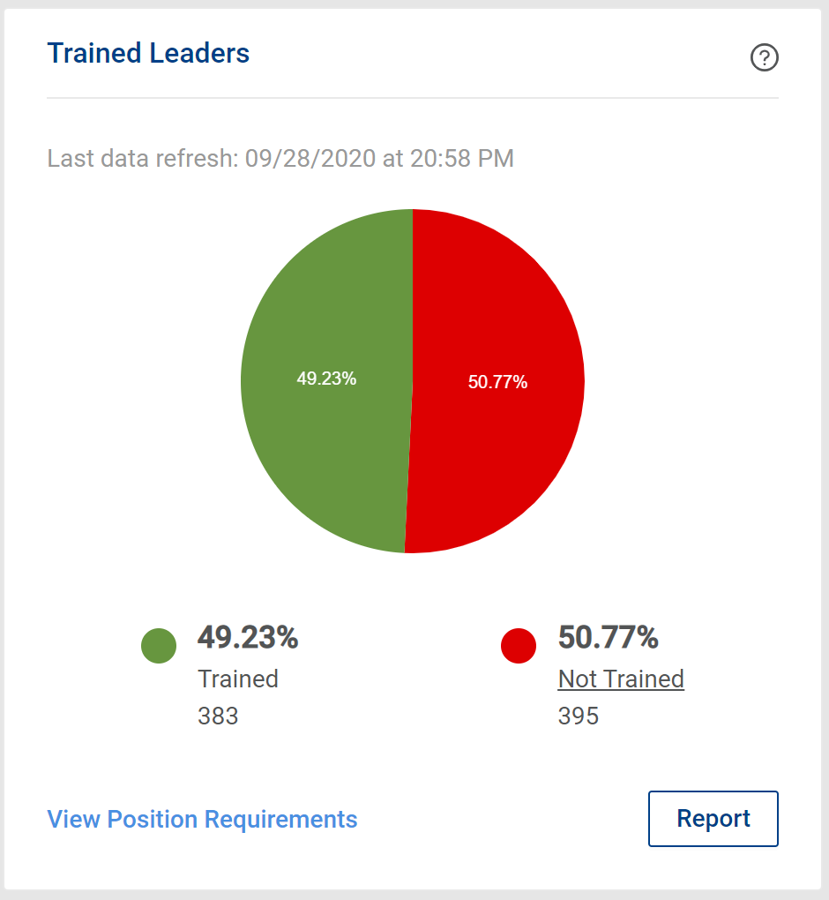
Trained Leaders as of 9/28/2020

Slide 16
Program Breakouts
Thank you for everything you do for scouting!

