Slide 1
Headwaters District Roundtable
September 2nd 2021

Slide 2
PLEASE BE RESPECTFUL
We will provide everyone a chance to talk and ask questions. Please mute your microphone during discussions to help cut down on background noise.

Slide 3
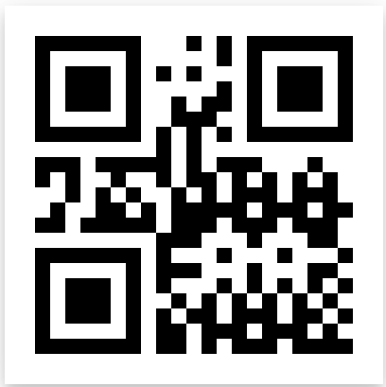
Please sign in
It helps us understand how we are doing and how we can improve your experience.
https://forms.gle/SkVPD8VfwzyvfH8v8

Slide 4
Welcome to our Virtual Roundtable
Welcome | 1 minute
Opening | 3 minute
Introductions | 1 minute
Safety Moment | 5 minutes
District News/Updates | 5 minutes
Rechartering | 20 minutes
Breakout Discussions | 25 minutes

Slide 5
Headwaters Roundtable team
Karen Nardone - Roundtable Commissioner
Arnold Oyola - Roundtable Commissioner
Timothy Howe - District Commissioner
Rob Hillman - Council Roundtable Staff Advisor

Slide 6
Covid update
CHECK FREQUENTLY – Changes continue!
BSA Covid Statement – Aug. 2021 (with resource links):
https://bit.ly/BSA-CovidStmt_Aug2021
Latest BSA National Guidance - 6/2/21:
https://www.scouting.org/coronavirus/covid-19-faq/
Latest Mayflower Council Guidance – 5/20/2021:
https://www.mayflowerbsa.org/faq-items/may-20-2021-covid-19-council-operations-update/

Slide 7
Covid update
Note: Mayflower Council continues to monitor the ever-developing situation and will issue additional guidance if/when deemed appropriate
Charter Organizations may impose other requirements – ENSURE TO CHECK!
Check for more restrictive local guidelines
Units must ensure to follow ALL relevant guidelines

Slide 8
Covid update
Covid Incident Notifications:
https://www.scouting.org/health-and-safety/incident-report/covid-19-incidents-exposures-supplemental-instructions/
https://www.mayflowerbsa.org/wp-content/uploads/BSA-Incident-Reporting-COVID-19-7.20.2020.pdf
https://bsapublicintakeportal.secure.force.com/

Slide 9
National/Council/District Updates
New 2021 Guide to Advancement
Scout Night at Polar Park, Sep. 10
Seven Seas Cub Fun Day, Sep. 11 Camp Squanto
Join Scouting Day, Sept 18. In YOUR town.
Webelos Woods, Sep. 25, Camp Squanto
Ground Patrol Search Camporee, Oct. 15-17, Camp Squanto
New Charter renewal system – details next month
Tantamous OA Lodge Fall Ordeal at Camp Resolute, Sep. 24-26
Headwaters District Recognition Cookout 10/3 at Camp Resolute
Tantamous OA Lodge Fall Ordeal at Camp Squanto, Oct. 22-24
Wood Badge 2022, Mar. 25-27 & Apr. 23-24
New Youth Safety Videos and Tools
“Betty Bot” – help for my.Scouting
Cubcast, Scoutcast & Seacast
“Cub Chat Live” – weekly livestream, 3PM, Fridays
Scoutlife Magazine Sampler available for
viewing/download
Freeze-Out 2022, Camp Resolute – Feb. 5-6

Slide 10
What is needed to recharter for 2022?
Unit Roster
Unit leaders need up to date training
Fees
JTE

Slide 11
Unit Roster
Roster maintenance should be a year round thing.
Keep the roster up to date.
Hanging on to applications is a bad idea.
Do you know:
Who is going to be spearheading the rechartering for your unit?
Which youth are continuing with the program and the unit?
Which youth are leaving the unit?
What about your leaders?
What leaders are registered with multiple units?
They only need to pay once

Slide 12
Unit Roster: Applications
Online applications make it easier for everyone.
Youth fees will be collected by National.
These will appear as pre-paid fees on the chartering paperwork.
New members will have fees collected for the remainder of 2021 and all of 2022 (15 months as of now.)
Adults can register online now too.
CORI forms for Massachusetts put us in the one off category in the past
Online CORI forms are now available:
https://www.mayflowerbsa.org/resources/cori-policy/

Slide 13
Unit Roster: New chartering system
A new chartering system is coming online.
10/15 is the go-live date for the new module
All units will be expected to be using this.
Training will be rolling out in September.
Stay tuned

Slide 14
Unit Roster: Training
All Unit leaders need to be have up to date YPT.
YPT Valid should be valid through 1/31/2022
This year should be much better than last year.
Be proactive in encouraging leaders to remain up to date.
Are YOU current?
Do you know when you are expiring?
Do you know how to pull the reports for your unit?

Slide 15
Unit Roster: Training
All Direct Contact leaders need to be have up to date Hazardous Weather Training.
Direct Contact leaders are:
Cub Scouts – Cubmaster, Assistant Cubmaster, Den Leader, Assistant Den Leader, Tiger Den Leader, Webelos Den Leader, Assistant Webelos Den Leader
Scouts BSA – Scoutmaster, Assistant Scoutmaster
Venturing – Advisor, Associate Advisor
Sea Scouting – Skipper, Mate
Exploring – Advisor, Associate Advisor

Slide 16
Fees
 | One time National Joining Fee | Annual National Membership Fee | Annual Mayflower Council Activity Fee | Total Fee for 2022
New Youth | $25 | $72 | $36 | $133
Renewing Youth |  | $72 | $36 | $108
Rejoining Youth |  | $72 | $36 | $108
Adult Volunteer |  | $45 |  | $45
Link to Mayflower 2021 fee document: https://www.mayflowerbsa.org/wp-content/uploads/Membership-Fees-by-Program-August-1-2021-Final.pdf
Notes:
Unit charter renewal fee: $75
Include prior registration number for dropped youth rejoining to avoid one-time joining fee
Per month fees for Aug/Sep/Oct/Nov/Dec 2021 – Youth: $9, Adult $3.75

Slide 17
Journey to Excellence (JTE)
This is a tool for the unit to use to gauge your program.
You will have a better program for the youth by focusing on continuous unit improvement
It is not used by the district and council to rank units
Be honest with answers
Update regularly

Slide 18
Journey to Excellence (JTE)
Forms have been updated for 2021
https://www.scouting.org/awards/journey-to-excellence/unit/

Slide 19
Rechartering: What was missing?
The annual charter agreement!
This was a traditional pinch point in units rechartering.
Council has tried to help
Council has been working with our charter organizations over the summer to complete the annual charter agreement
For most units this has already been done
Check with your COR to see if this has already been completed.

Slide 20
What can you do now?
Start figuring out who is coming back
Get any apps that have been lying around into the system now.
Start looking at JTE
Check training records and encourage leaders to complete training
Ensure that the leader who is heading up the rechartering effort is a Key 3 delegate

Slide 21
Review sessions?
Last year we did virtual review sessions from October through December.
Unclear if we will do that again, stay tuned.
If your unit needs help, please reach out to the commissioner corps.

Slide 22
Unit rechartering resources
Mayflower.org
https://www.mayflowerbsa.org/resources/unit-management/internet-rechartering/
Key 3 Delegate
https://www.mayflowerbsa.org/changing-my-scouting-functional-roles/

Slide 23
Program Breakouts
Thank you for everything you do for scouting!

Slide 24
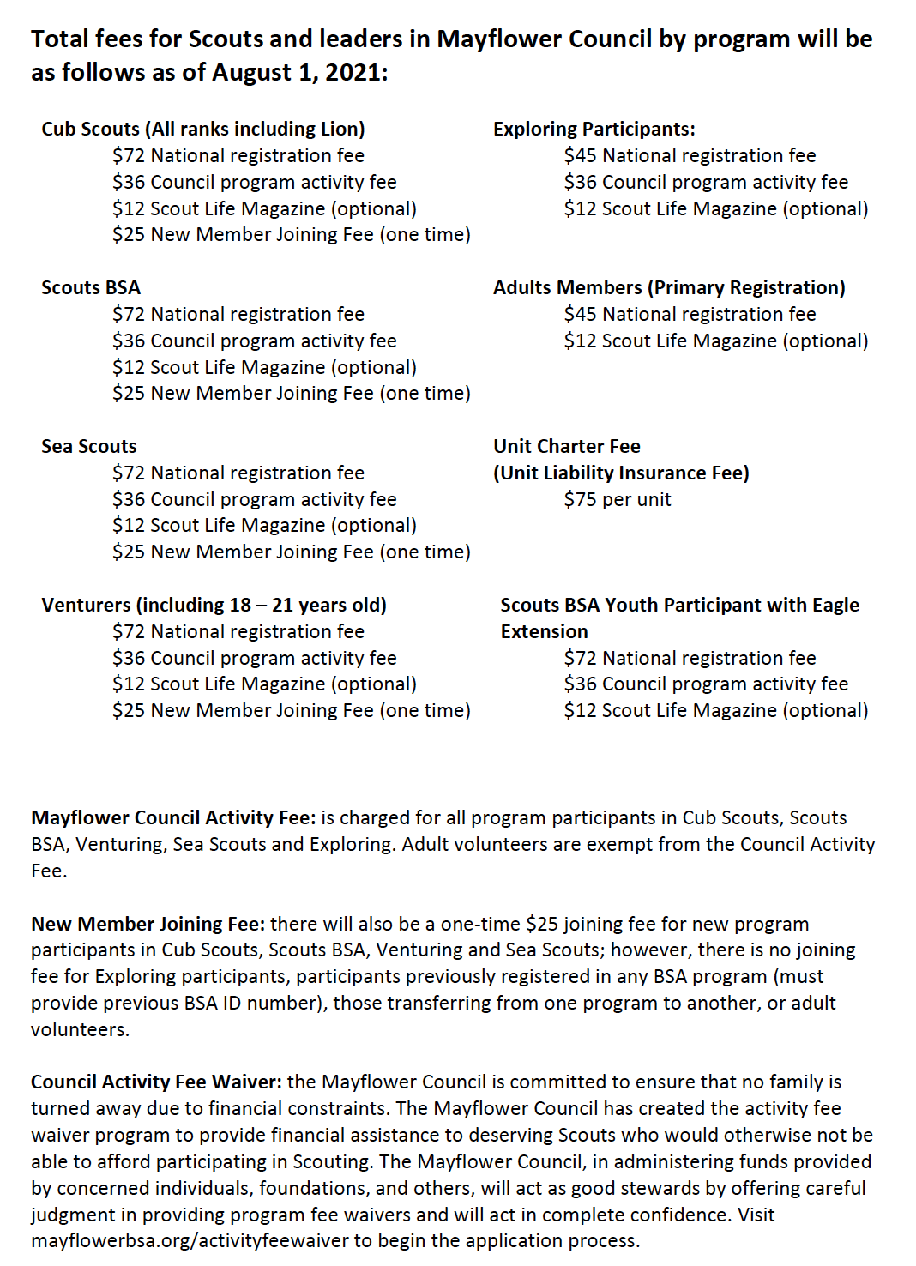
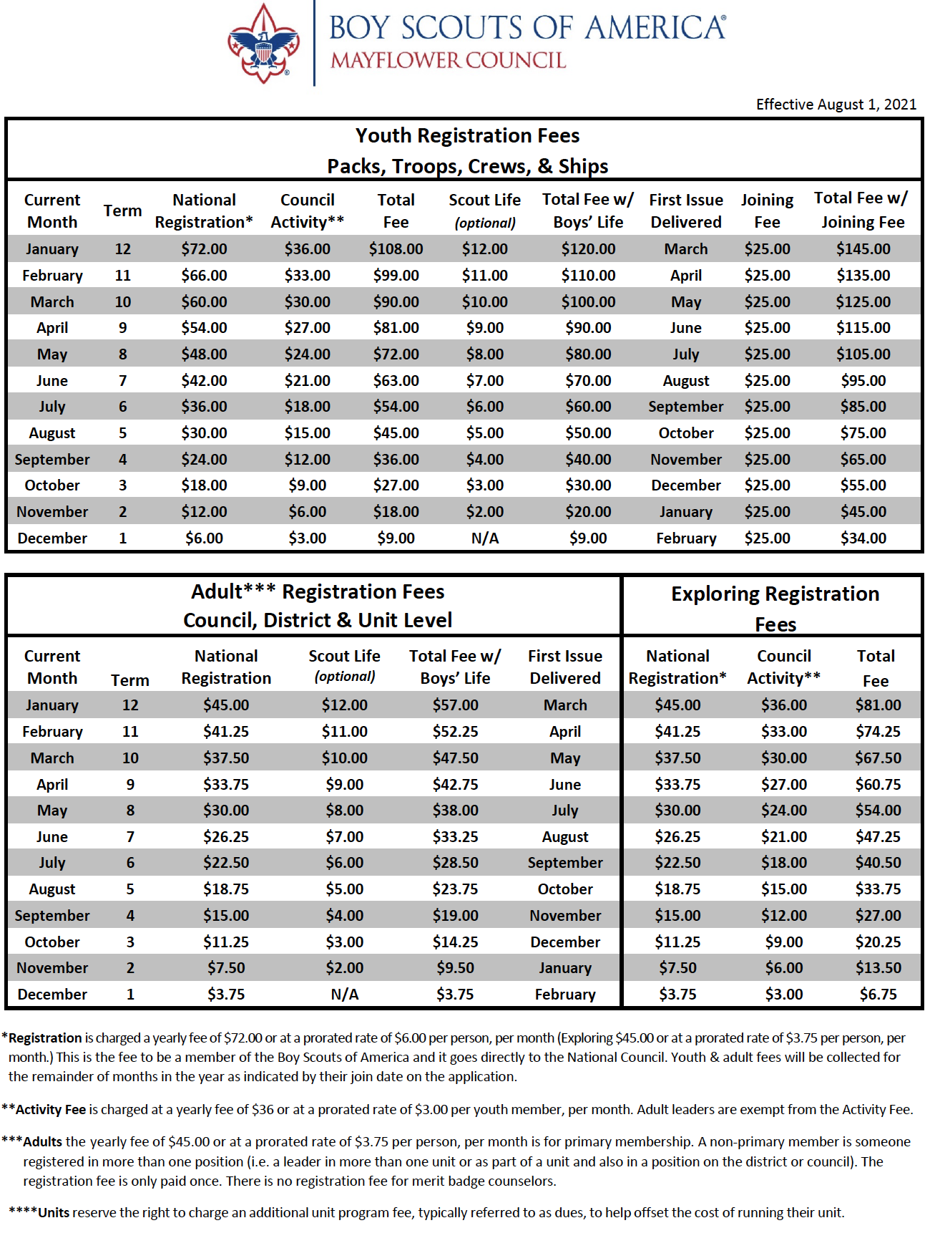
Link:
2021 Registration Fees

Slide 25
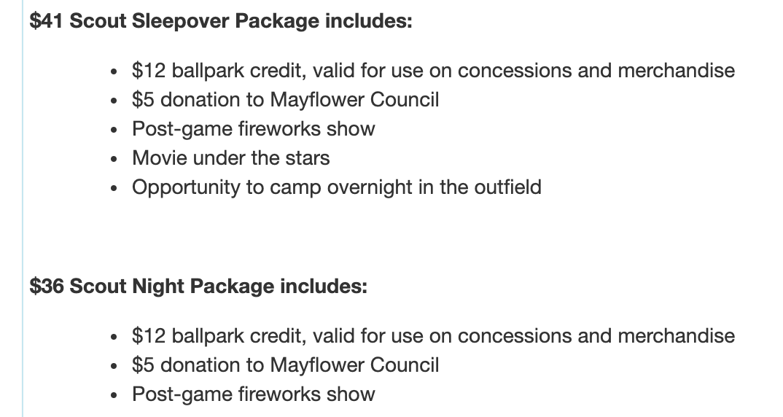
Scout night at the WOO SOX
Information Flyer Order Tickets

Slide 26
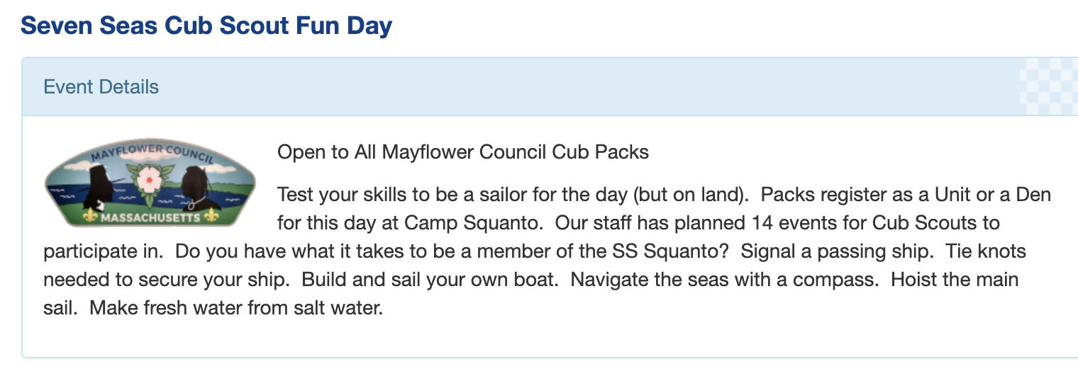
Seven Seas Cub Scout Fun Day
Links:
Information Flyer Leader Guide Register

Slide 27
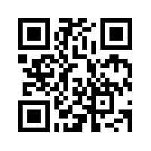
Webelos Woods
September 25, 2021
https://scoutingevent.com/251-Webeloswoods2021
Attend as a Pack, Den, or Individual
Open to All Mayflower Council Webelos
The weekend will focus on Cast Iron Chef, Camper, Webelos Walkabout and Outdoor Adventure. If your Den has already completed an adventure, we encourage them to do it again and strengthen their skills. Also, Webelos can complete Arrow of Light adventures.
Dens are welcome to arrive Friday night and camp. Dinner of hot dogs and hamburgers will be provided on Saturday. Check the leader’s guide for more details on schedule and meals for the weekend.
Event Flyer: https://scoutingevent.com/?ORgKey=BSA251&calendarID=322609

Slide 28
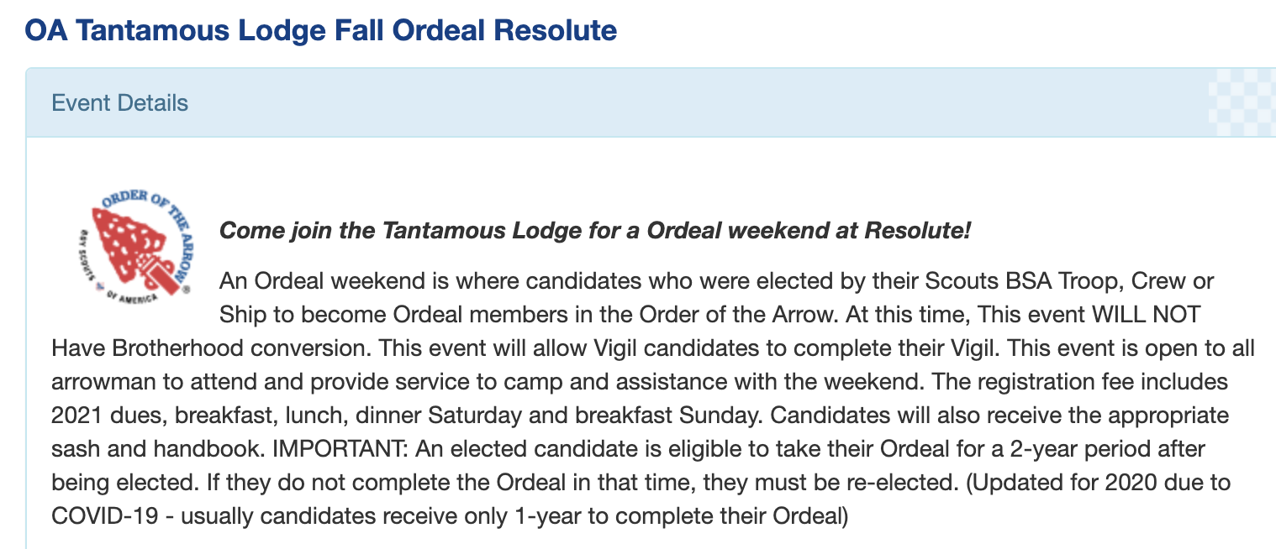
Information Register

Slide 29
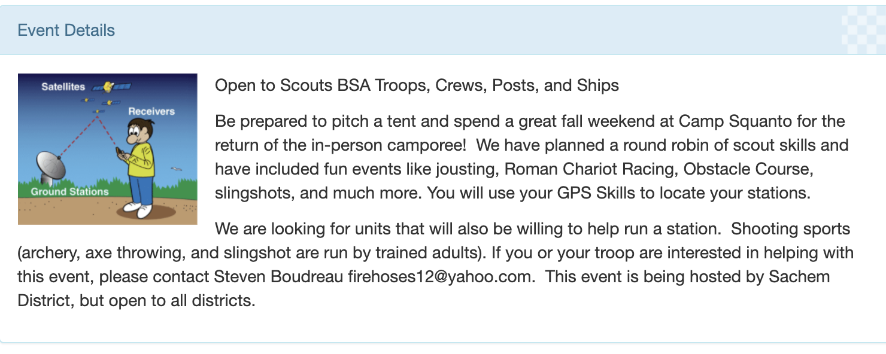
Ground Patrol Search (GPS) Camporee
LINKS:
Flyer
Leader Guide
Register

Slide 30
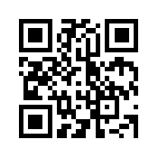
USAF SERE TRAINING SURVEY
Date TBD
https://forms.gle/UVykUXw7h63RWxXA9
USAF SERE (Survival, Evasion, Resistance and Escape) Training For Scouts - We have been approached by a USAF Recruiter regarding a Scout version of their SERE Training they would like to offer. The program would be geared toward Scouts and Venturers 14 years old and above (Venturers up to 20). In order to move forward, we would like to see what the interest level would be from our Scouts. There would be a cost to cover meals Scouts would prepare.
They offer several options, but we are considering an Arctic Survival program during a Freezeout. Please rank which your scouts would be interested in.

Slide 31
New Charter Renewal Process
New System will be Simpler to Use:
No address codes are necessary
Single screen will address all recharter tasks
Simpler process anticipated to speed up completion
Plan to use Scoutbook/Internet Advancement log-in
Training planned for September
“Sandbox” will be available
Allows practice use without altering charter data
System will go “live” Oct. 15
Units should ensure rosters (my.scouting) accurate BEFORE Oct. 15

Slide 32
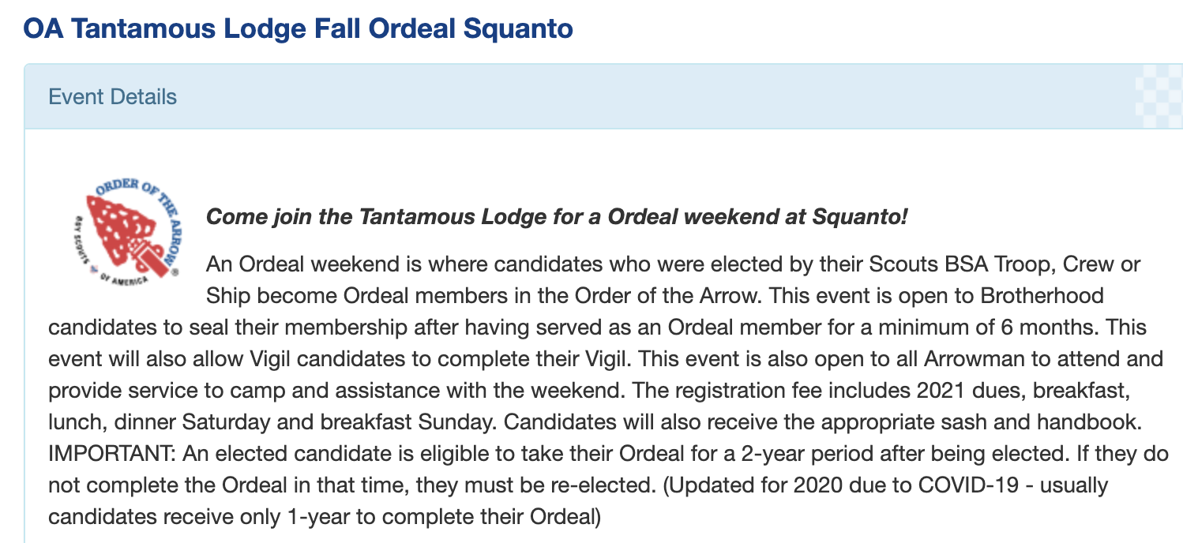
Information Register

Slide 33
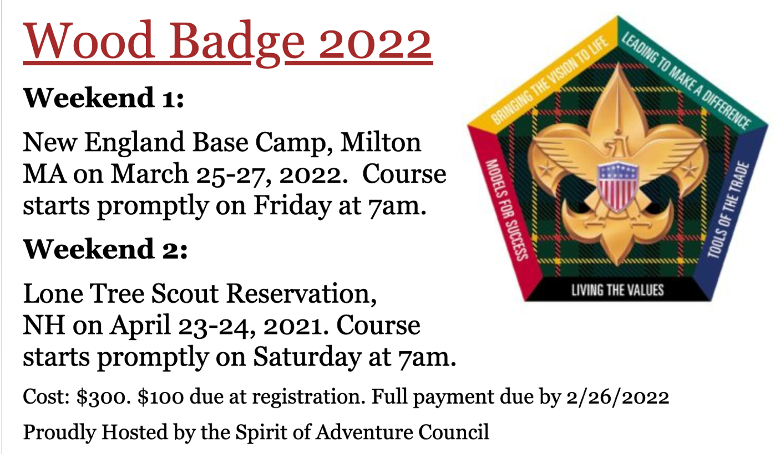
Course postponed from 2020
Info Link:
https://scoutspirit.doubleknot.com/event/wood-badge-2021/2717353
Registration:
https://scoutspirit.doubleknot.com/registration/register.aspx#

Slide 34
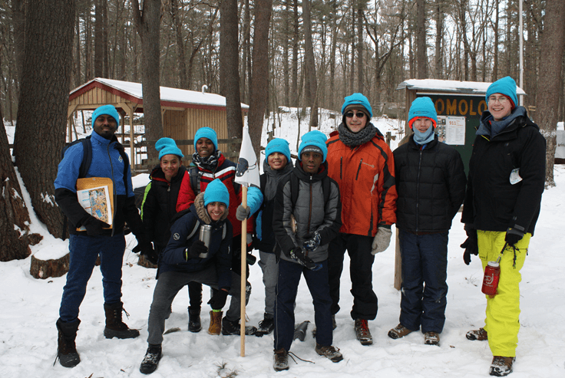
Freezeout At Camp Resolute
February 5-6, 2022
Save the date!
Mark
Kick off
Scan
Mark your calendars for the 2022 Freezeout at Camp Resolute. Join us for winter camping fun and competition. Special activities are being planned for older Scouts and Venturers.
Our committee will kick off planning on August 25 and if you or your unit are interested in helping, please contact Dennis Mauro at mauro257@verizon.net
You can scan the QR Code for Dennis’ email address as well

Slide 35
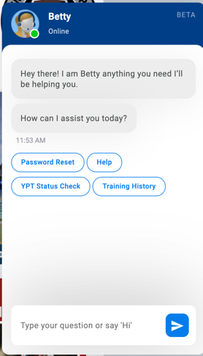
Other Information and Links
New 2021 revision to Guide for advancement: Read/download the guide, 11 key changes note
New Youth Safety Awareness Videos: Link to article and tools
Scout Life Magazine Sampler
BSA Podcasts: Cubcast, Scoutcast, Seacast
Cub Chat Live – weekly Facebook livestream, Fridays, 3 PM Eastern Information Article Past Recordings
“Betty Bot” – help on my.scouting:
Betty Bot is a new addition to my.scouting.org and she can make it simpler and easier to do three things all volunteers need to do from time to time:
Reset your password, Check the status of your YPT training,
Review a summary of your training history
Once you’ve logged on to my.scouting.org, look for a blue circle with a flag
in the lower right corner of your screen. Click on it, and you’ll meet Betty.
Betty is in beta…that means she’s still learning how best to help us; but when we ask, like all good Scouts she’ll do her best to serve.

