Slide 1
Headwaters District Roundtable
September 1st, 2022

Slide 2


Please be Courteous and Kind
We will provide everyone a chance to talk and ask questions. Please mute your microphone during discussions to help cut down on background noise.
We will provide everyone a chance to talk and ask questions. Please mute your microphone during discussions to help cut down on background noise.

Slide 3
Welcome to our Virtual Roundtable
Welcome | 1 minute
Opening | 3 minute
Introductions | 1 minute
District News/Updates | 2 minutes
Rechartering | 10 minutes
Recruiting | 10 minutes
Open Discussions | 20 minutes

Slide 4
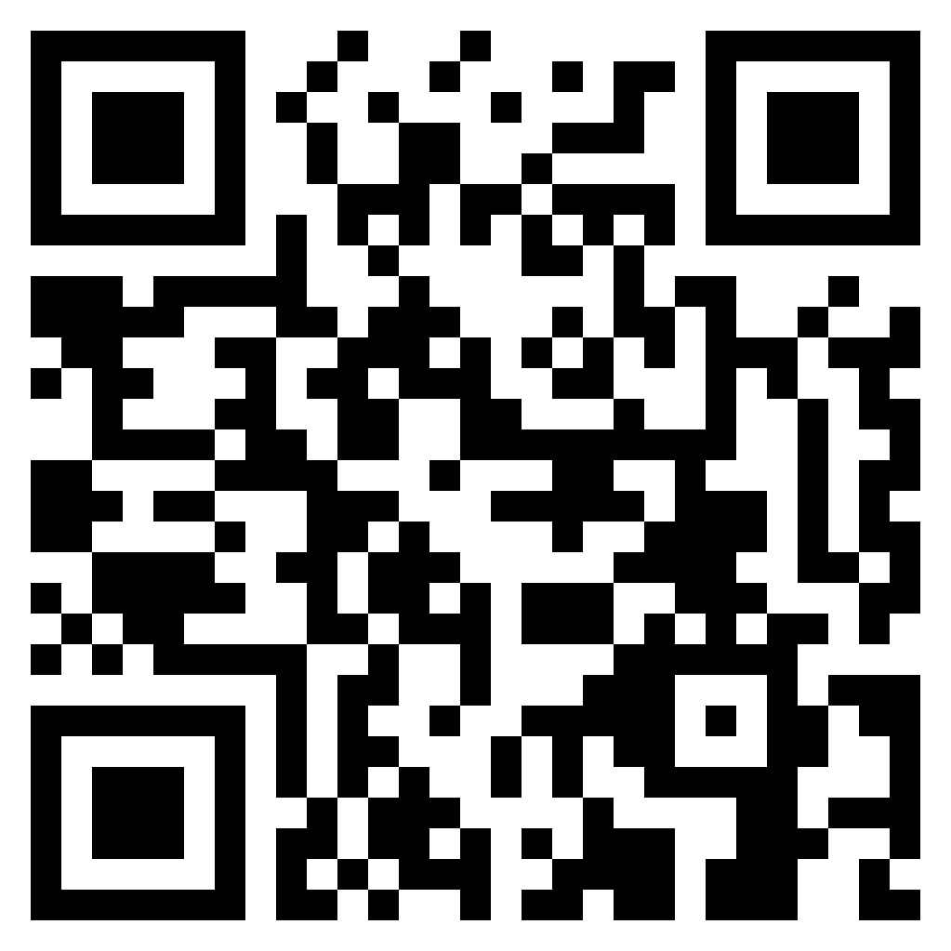
Please Sign in
It helps us understand how we are doing and
how we can improve your experience.
https://forms.gle/AZYGQTASkZyb865Z6

Slide 5
Headwaters Roundtable team
Karen Nardone - Roundtable Commissioner
Quint Roth - Roundtable Commissioner
Timothy Howe - District Commissioner

Slide 6
District Updates
Recycled Regatta @ Squanto 9/9-9/11
Baloo Training @ Squanto 9/17-9/18
Success Workshops. Virtual. 9/12, 9/28
Webelos @ Squanto 9/24
Pioneering Camporee @ Resolute 9/30-10/2
Halloween Fun Day @ Squanto 10/15
Webelos Adventure Meet @ Resolute Basecamp 10/15
Survival Camporee @ Squanto 11/4-6
Scouting For Food, 11/5 and 11/12
Dutch Oven Cookoff @ Nobscot 11/12
Freezeout @ Resolute 2/3-5 2023.
Klondike Derby @ Squanto 2/11/23

Slide 7
Rechartering
Its is that time of the year!

Slide 8
What is needed to recharter for 2023?
Unit Roster
Unit leaders need up to date training
It is very likely that your leaders will need to refresh YPT this year.
Fees
JTE

Slide 9
Unit Roster
Roster maintenance should be a year round thing.
Keep the roster up to date.
Do you know:
Who is going to be spearheading the rechartering for your unit?
Which youth are continuing with the program and the unit?
Which youth are leaving the unit?
What about your leaders?
What leaders are registered with multiple units?
They only need to pay once

Slide 10


Slide 11
Unit Roster: Training
All Unit leaders need to be have up to date YPT.
YPT Valid should be valid through 1/31/2023
It is very likely that most of your leaders will need to redo YPT.
Please start now.
Be proactive in encouraging leaders to remain up to date.
Are YOU current?
Do you know when you are expiring?
Do you know how to pull the reports for your unit?

Slide 12
Unit Roster: Training
All Direct Contact leaders need to be have up to date Hazardous Weather Training.
Direct Contact leaders are:
Cub Scouts – Cubmaster, Assistant Cubmaster, Den Leader, Assistant Den Leader, Tiger Den Leader, Webelos Den Leader, Assistant Webelos Den Leader
Scouts BSA – Scoutmaster, Assistant Scoutmaster
Venturing – Advisor, Associate Advisor
Sea Scouting – Skipper, Mate
Exploring – Advisor, Associate Advisor

Slide 13
Fees
 | One time National Joining Fee | Annual National Membership Fee | Annual Mayflower Council Activity Fee | Total Fee for 2022
New Youth | $25 | $75 | $36 | $136
Renewing Youth |  | $75 | $36 | $111
Rejoining Youth |  | $75 | $36 | $111
Adult Volunteer |  | $45 |  | $45
Link to Mayflower 2022 fee document:
https://www.mayflowerbsa.org/wp-content/uploads/Registration-Fees-with-Program-Detail-08.01.2022.pdf
Notes:
Unit charter renewal fee: $75
Per month fees for Aug/Sep/Oct/Nov/Dec 2022 – Youth: $9.25, Adult $3.75

Slide 14
Journey to Excellence (JTE)
This is a tool for the unit to use to gauge your program.
You will have a better program for the youth by focusing on continuous unit improvement
It is not used by the district and council to rank units
Be honest with answers
Update regularly

Slide 15
Journey to Excellence (JTE)
Forms have been updated for 2022
https://www.scouting.org/awards/journey-to-excellence/unit/

Slide 16
What can you do now?
Start figuring out who is coming back
Start looking at JTE
Check training records and encourage leaders to complete training
Ensure that the leader who is heading up the rechartering effort is a Key 3 delegate

Slide 17
Unit rechartering resources
Mayflower.org
https://www.mayflowerbsa.org/resources/unit-management/internet-rechartering/
Key 3 Delegate
https://www.mayflowerbsa.org/changing-my-scouting-functional-roles/

Slide 18
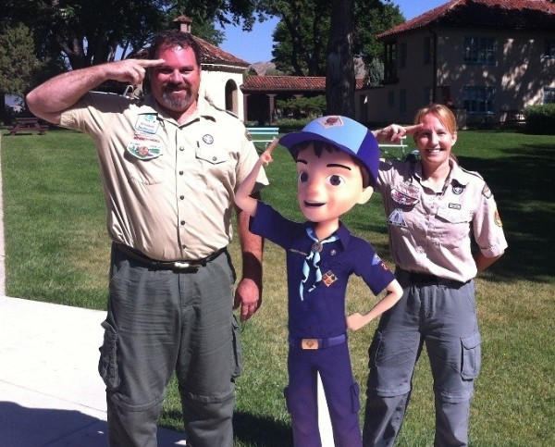
5 Tips for Join Scouting Day Success!
Make sure your lawn signs are in HIGH VISIBILITY PLACES: by Schools, Shopping Centers, public library, your local polling places, and places where moms and families go!
Go into Invitation Manager and check for any active leads (and CLOSED LEADS) and invite them to your Join Scouting Day event
Have your current Cub Scouts invite a buddy (use the Buddy Cards provided)
Post your Join Scouting Day event(s) on your Facebook page (personal and unit) and share in your community pages
Plan a 2nd event: Back to School Night, etc.

Slide 19

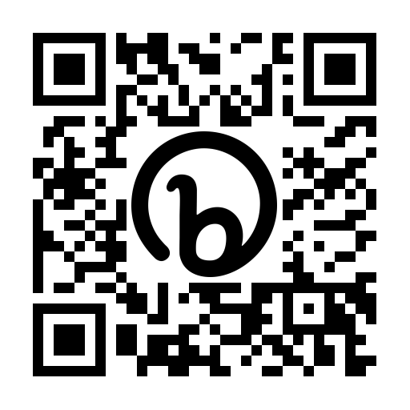

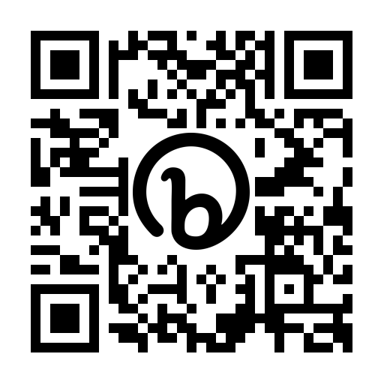

Fall Recruitment Opportunities for Scouts BSA, Venturing Crews & Sea Scouts
The Mayflower Council’s Slices for Scouting Program encourages our Scouts BSA Troops to have a pizza party where friends of current Scouts and students in 5th or 6th grade can attend and learn about their local Troop and the Scouting Program overall.
Scouts BSA Troops can sign up for this program which includes FREE PIZZA for their Pizza Party before September 17th
Scan the QR code or visit the website below for details on planning your Slices for Scouting Membership Event!
https://bit.ly/3px5d4p
31 Day Challenge for Venturing Crews and Sea Scout Ships: Crews and Ships will compete in a challenge to see who can recruit the most new members in the month of October The winning Crew or Ship will receive a $25 per person stipend for use on a future unit adventure.
Scan the QR code to watch the Fall Recruitment Kick Off Video for more details!
https://bit.ly/3AWpS8z

Slide 20
Program Breakouts

Slide 21
How did your units summer go?
Did your scouts participate in your summer program?
What was your summer program?
What went well?
What could be improved?
How to build on that momentum for the fall?

Slide 22
Appendix

Slide 23

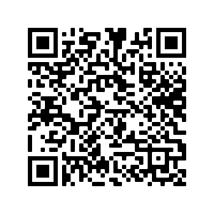
2022 Popcorn Fundraiser
Popcorn District Kernels are needed for the following Districts: Metacomet – Sachem - Post Road
These volunteers will work with the Council Popcorn Kernel & Popcorn Staff Advisor to support units in their fundraising efforts.
2022 Popcorn Important Dates are:
Help with Sorting
September 7 @ Westborough from 1 - 4pm
Scan the QR code to register
Pick Up Show & Sell Order
September 10 @ Westborough between 8- 9:30am
For more information: visit - https://www.mayflowerbsa.org/about/funding/popcorn/

Slide 24

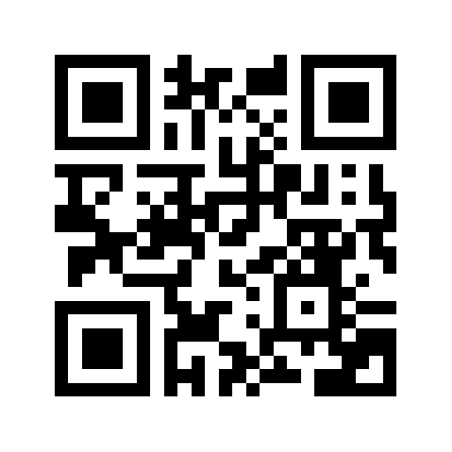
National Service Territory 11
Recycled Regatta
September 9th-11th; Camp Squanto
Hosted by Mayflower Venturing Officers Association
Open to all New England Council Units and Mayflower Venturing Crews
Units will design and build a boat from recycled materials between now and race day and then race it against other groups on the regatta weekend.
Turn your junk into a float worthy craft to compete with other Units.

Slide 25
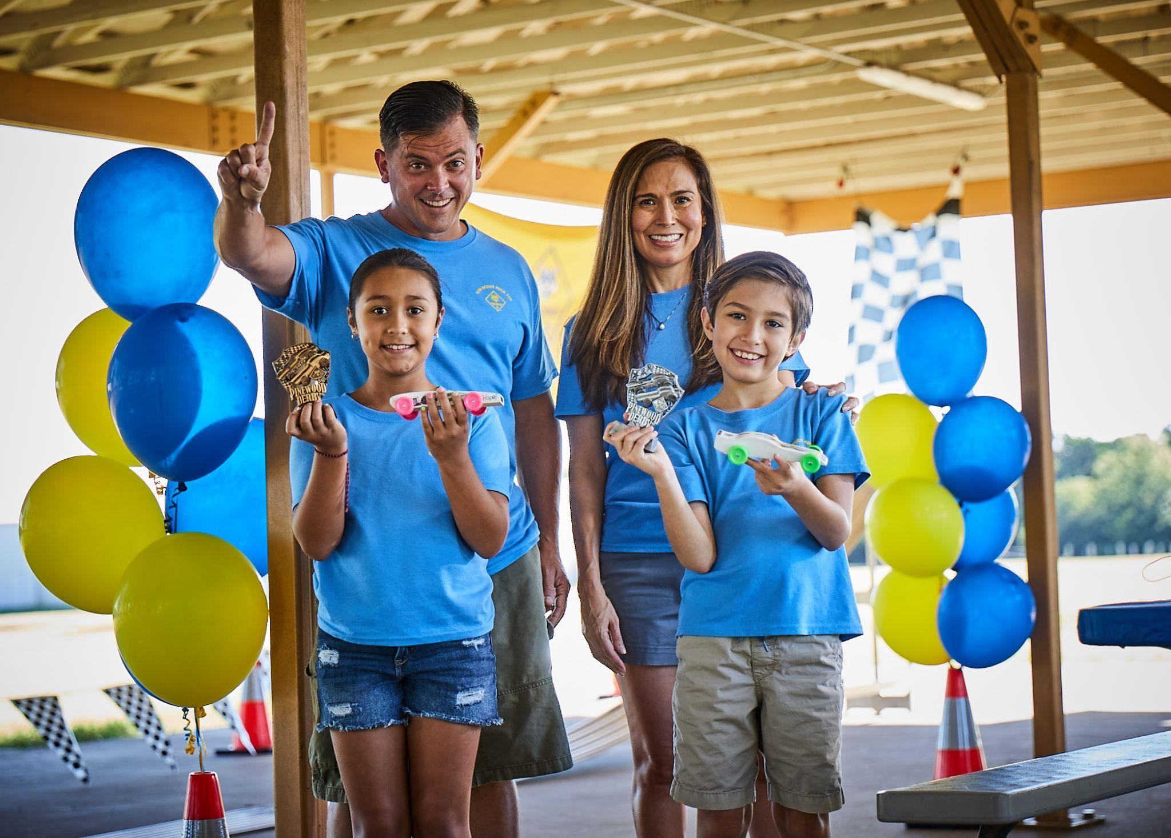
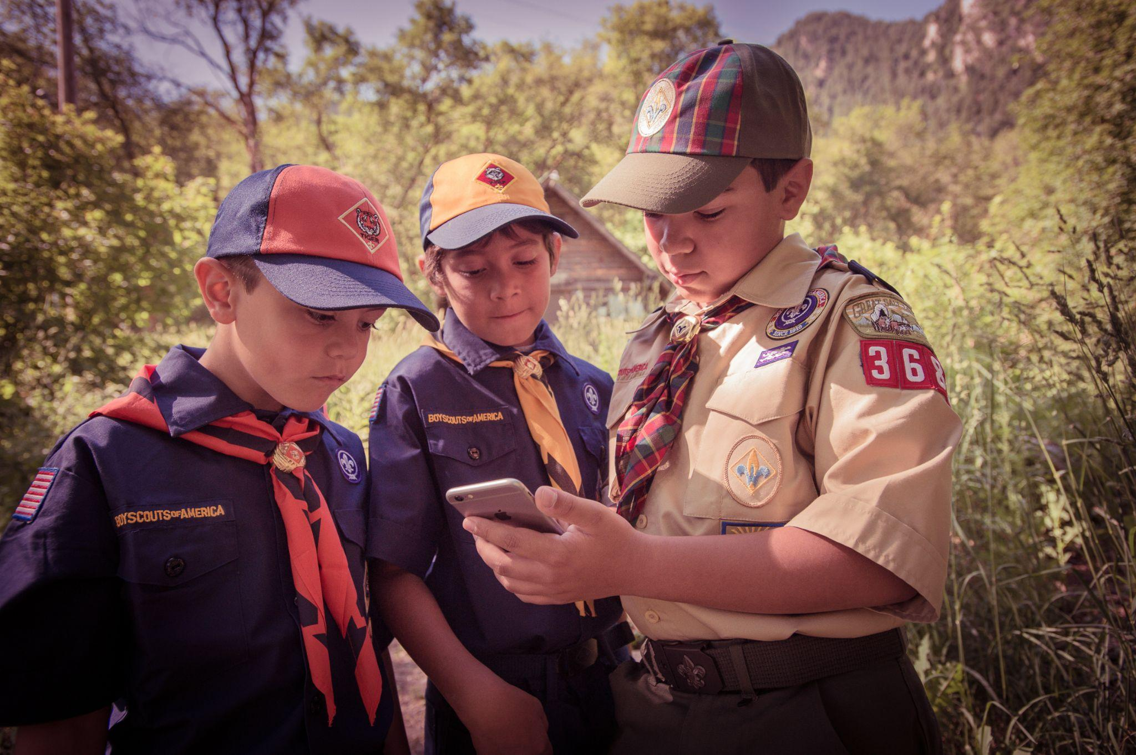
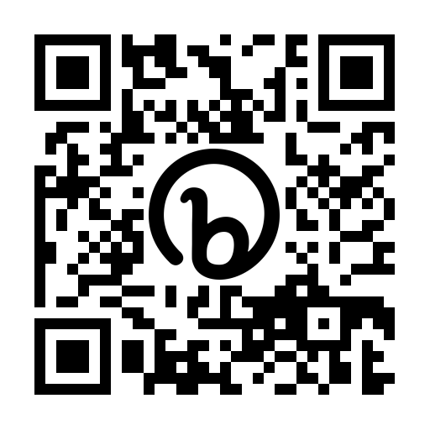
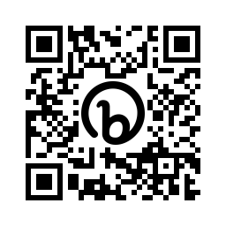
Upcoming Unit Success Workshops
Volunteer Recruitment
Monday, September 12th; 7PM
Webelos To Scout Transitions
Wednesday, September 28th; 7PM
With new Cub Scouts joining as part of Join Scouting Day, this is a great opportunity to recruit some new adult volunteers.
We will discuss the importance of creating a “volunteer driven, professionally guided” environment for your unit, explaining the role, making sure the person and the role fit and more!
Starting the new Scouting year means your 2nd year Webelos will begin looking ahead to Scouts BSA.
This workshop is for both Cubmasters, Webelos Leaders and Scoutmaster alike. We will be discussing timelines for success, each leaders role in the process and more!
https://bit.ly/3CHx0a7
https://bit.ly/3dr8BeI

Slide 26

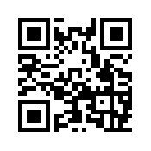
Webelos Woods
September 24, 2022
Attend as a Pack, Den, or Individual – for Webelos and Arrow of Light
Hosted by Cranberry Harbors and Sachem Districts - Open to All Mayflower and neighboring council Webelos
Cast Iron Chef, Webelos Walkabout, Outdoor Adventure, Castaway and Into the Woods
One Day Event but units are welcome to reserve a cabin or tent site to make a weekend of it.
$20 per youth, $5 per adult
Registration closes September 8 and there is a $5 late fee after that
Leader’s Guide available on the registration site
https://scoutingevent.com/251-Webeloswoods2022

Slide 27

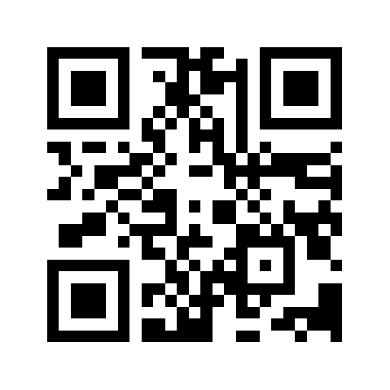
Pioneering Fall Camporee At Resolute
September 30 – October 2, 2022
Hosted by Camp Resolute Base Camp, T99 Franklin, T303 Marlborough, T100 Westborough, and T1 Stow - Open to All Mayflower and neighboring council Troops and Crews
Fire Starting, Tomahawk Throwing, Two Person Saw, Log Lift, Davinci (Friction) Bridge and more
Leader’s Guide on the registration page
https://bit.ly/3wFc7bZ

Slide 28
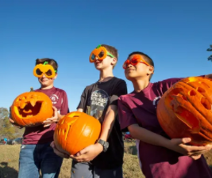
Halloween Cub Fun Day
October 15, 2022
Don’t be a scaredy cat, celebrate Halloween with us!
Open to All Mayflower Council Cub Packs
The schedule will be open for scouts to come and go when its convenient for them. Anytime between 10-4. This should allow any scouts that have sports on Saturday morning to come down to camp after their games.
This will be a great activity for new scouts and their families too!
There are lots of activities planned with a Halloween theme with a Cub Scout twist - Pumpkin Chunkin with toilet tissue, Eyeball Hunt, Pumpkin Mini-golf, Eyeball Pong, Feed The Monster Bean Bag Toss, Pin The Bones On The Skeleton, Mummy Bowling and more. There will also be a scavenger hunt and what is Halloween without treats…treats…treats!
Leave the uniform at home and wear your best Halloween costume! Reg Youth cost: $12 by Oct 3rd, after Oct 3rd the cost is $15/youth
https://bit.ly/3e8O5Qf

Slide 29

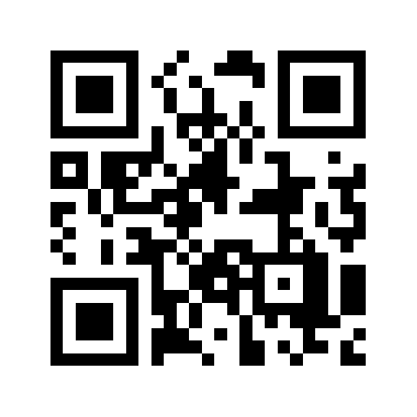
Webelos/AOL Adventure Meet At Base Camp
October 15, 2022
Attend as a Pack, Den, or Individual – for Webelos and Arrow of Light
Hosted by Camp Resolute Base Camp and local units - Open to All Mayflower and neighboring council Webelos
One Day Event but units are welcome to reserve a cabin or tent site to make a weekend of it.
Aquanaut, First Responder, BB’s, Archery, Cast Iron Chef, Castaway, Into the Woods/Wild
$20 per Scout, $5 per adult, $5 late fee after Oct 1
https://bit.ly/3QpbU4c

Slide 30
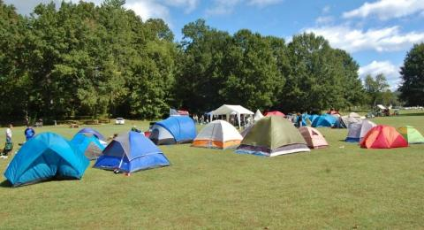
Survival Fall Camporee At Squanto
November 4-6, 2022
Open to Scouts BSA Troops, Crews, Posts, and Ships
Troops, Crews and Ships come strengthen your skills at the "Survival Camporee“
10 Stations including archery enhance your team building skills and scout knowledge.
Search and Rescue, Shelter Building, Bear Bag Hang, Water Carry, and more
Leader’s Guide on the Registration Page
https://scoutingevent.com/251-fallcamporee22

Slide 31

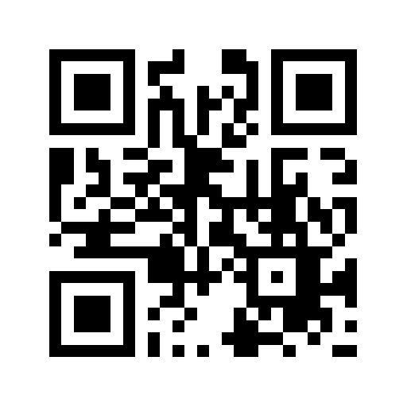
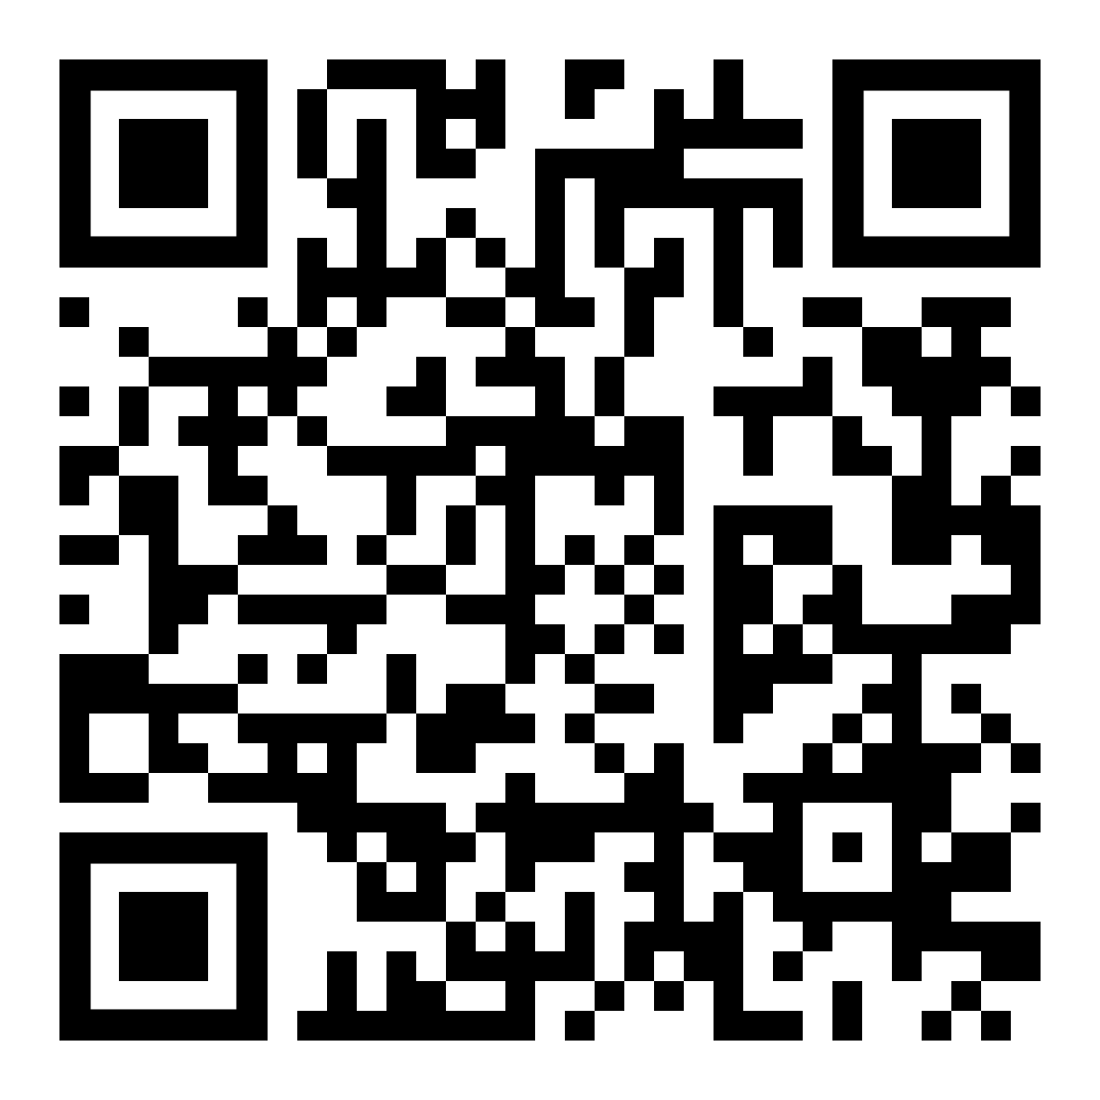
MARK YOUR CALENDARS!
Scouting for Food
November 5th & 12th!
Mark your calendars for this National Good Turn or select dates that work best for your local food pantry and your unit.
Mayflower Council is working with past corporate sponsors to support and provide door hangers
Mayflower Council will provide Covid-19 Guidance and suggestions for contactless food collections to keep everyone safe!
Scan Code For Info
Email

Slide 32
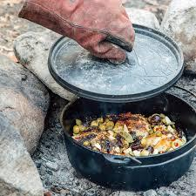

1st Annual Dutch Oven Cook-Off
November 12th at Nobscot Reservation Haydenland Meadow 11am – 5pm
Units, register your Scouts and leaders to join us for a day of music, games, and delicious food.
Patrols of up to 5 scouts and 2 adult leaders can register for 1 of 3 food categories ($25 entrance fee)
Main Course
Dessert
Cracker Barrel
Adult Patrols are encouraged to enter our King of the Cast Iron - Open Menu Category ($30 entrance fee)
Spectators will vote on their overall favorite dish for the Wooden Spoon Award

Slide 33

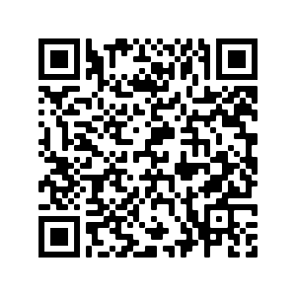
Freezeout At Camp Resolute
February 3-5, 2023
Save The Date
Mark
Events
Volunteer
Mark your calendars for the 2023 Freezeout at Camp Resolute. Join us for winter camping fun and competition. Special activities are being planned for older Scouts and Venturers. Webelos can attend with Troops on Saturday.
Round Robin Events, activities for older Scouts, and the sled race of course!
Please contact Dennis Mauro to volunteer!

Slide 34
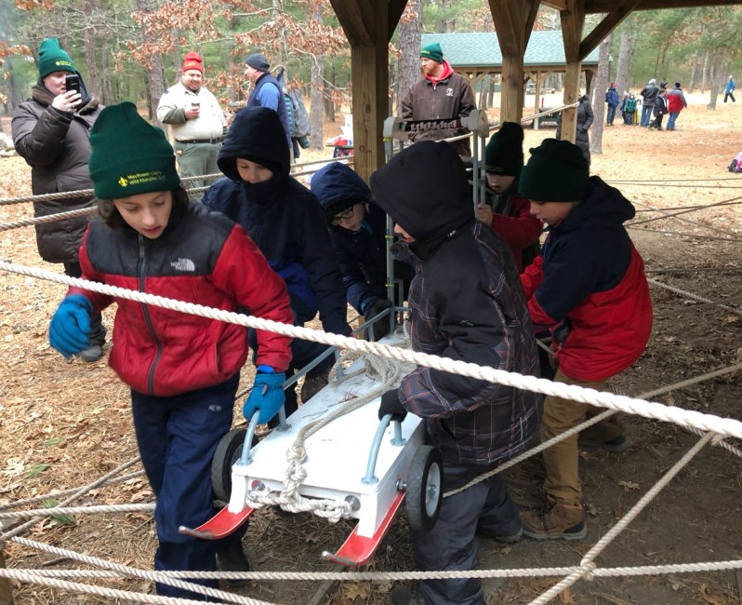
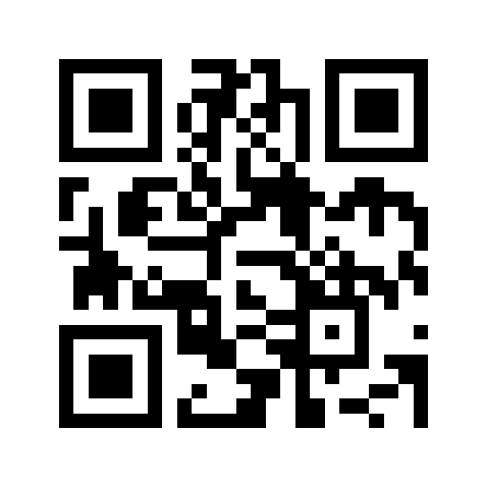
2023 Klondike Derby At Squanto
February 11, 2023
Open to Troops, Crews, Ships, Webelos & AOLs
Enhance your team building skills and Scout knowledge at various stations
Webelos/AOL and Troop/Crew/Ship divisions
Open to all Mayflower Units
Hot meal at dining hall included and patches for all participants.
Hats may be ordered at an additional cost.
One Day Event, units can reserve cabins or camp sites to stay over
https://scoutingevent.com/251-Klondike2023

Slide 35

Baloo the Builder Workshops
We’ll bring the tools and building supplies, you bring the bears!
Each Bear Scout must complete their Baloo the Builder Adventure Loop to earn their Rank
Learn the basics of tools
Complete 1 useful building project
Complete 1 fun building project
Apply a finish to 1 project
Book the workshop through the Mayflower website with 2 options:
$175 – at a Mayflower hosted property
$200 – at a Pack hosted location
Multiple project options available when booking!
Each scout will leave with 2 completed projects and their adventure loop finished

Slide 36


Mayflower Adventure Boxes
Everything you need to complete an adventure in one box!
Boxes are available for rent directly from the Mayflower website
3 Belt Loop or Pin options per rank
Each $20 rental is mailed to the leader’s house with a return shipping label to return to the council office by the end of the 2-week rental period
Inside is a list of items to keep and items that must be returned
Each kit will include supplies for up to 10 scouts
Once you have completed the adventure:
Repackage the returnable items in the original package
Attach the return label
Drop off at your local shipping location

Slide 37

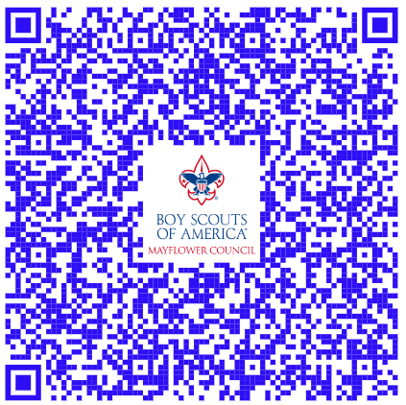
Virtual Merit Badge Classes
Now Available Year Round
Classes available throughout the year
All hosted by Mayflower registered counselors!
Great opportunity to fill in missing or incomplete merit badges
Scouts can sign up a la carte on the Mayflower website
$20 per class
Counselors interested in hosting classes can reach out to Logan Ferraro via the QR code below

Slide 38
5 Tips for Join Scouting Day Success!
Make sure your lawn signs are in HIGH VISIBILITY PLACES: by Schools, Shopping Centers, public library, your local polling places, and places where moms and families go!
Go into Invitation Manager and check for any active leads (and CLOSED LEADS) and invite them to your Join Scouting Day event
Have your current Cub Scouts invite a buddy (use the Buddy Cards provided)
Post your Join Scouting Day event(s) on your Facebook page (personal and unit) and share in your community pages
Plan a 2nd event: Back to School Night, etc.

Slide 39
Fall Recruitment Opportunities for Scouts BSA, Venturing Crews & Sea Scouts
The Mayflower Council’s Slices for Scouting Program encourages our Scouts BSA Troops to have a pizza party where friends of current Scouts and students in 5th or 6th grade can attend and learn about their local Troop and the Scouting Program overall.
Scouts BSA Troops can sign up for this program which includes FREE PIZZA for their Pizza Party before September 17th
Scan the QR code or visit the website below for details on planning your Slices for Scouting Membership Event!
https://bit.ly/3px5d4p
31 Day Challenge for Venturing Crews and Sea Scout Ships: Crews and Ships will compete in a challenge to see who can recruit the most new members in the month of October The winning Crew or Ship will receive a $25 per person stipend for use on a future unit adventure.
Scan the QR code to watch the Fall Recruitment Kick Off Video for more details!
https://bit.ly/3AWpS8z

Slide 40
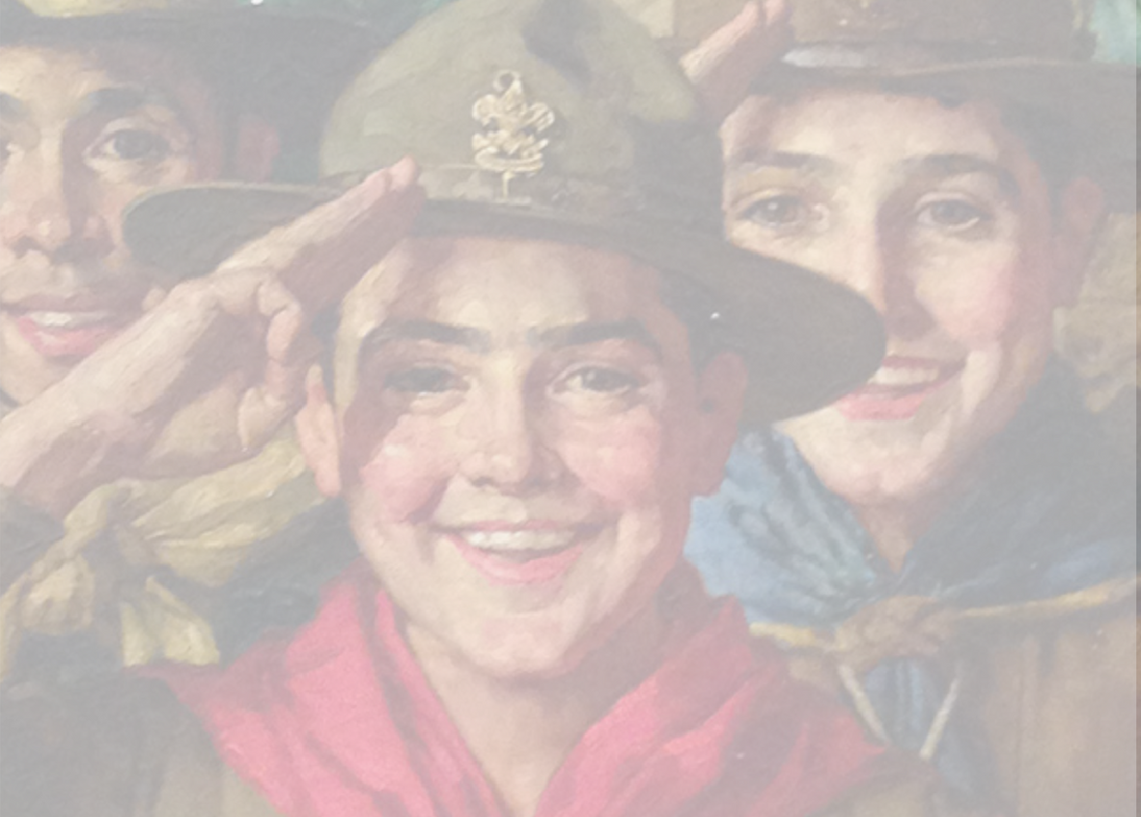
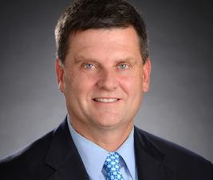
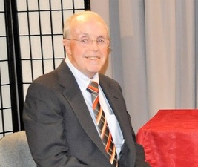

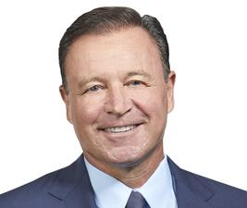

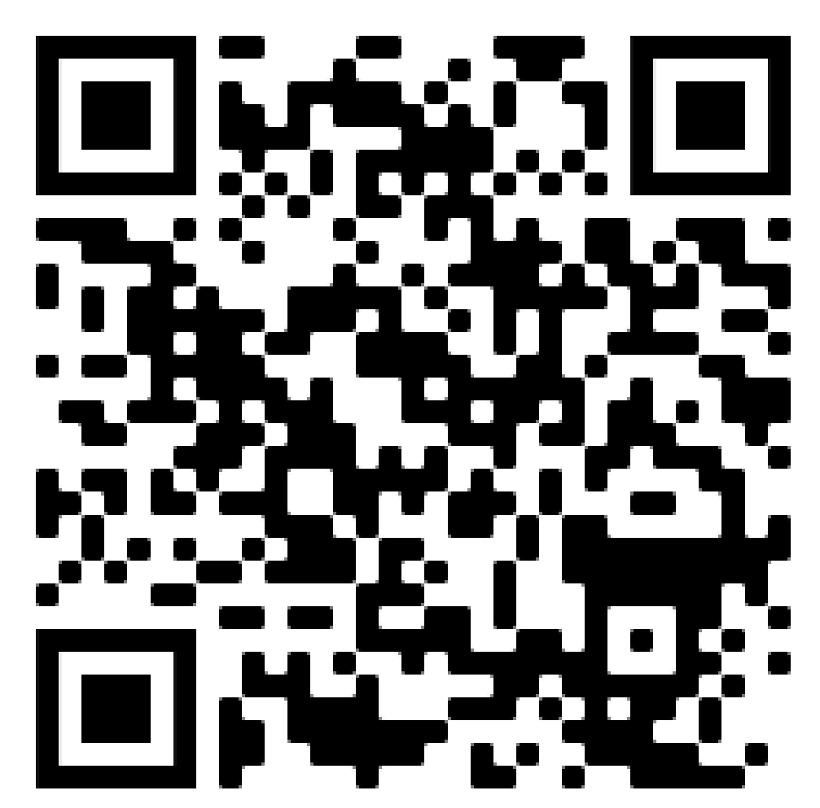
Distinguished Citizens Award Dinner (DCAD)
Join us on October 18 at Lombardo’s in Randolph as we celebrate our 2022 DCAD honorees:
Distinguished Citizen Award Distinguished Scouter Award
James M. Dunphy, President & CEO Arnold Briggs, Educator (retired)
South Shore Bank Scouter & Community Volunteer
Second Century of Leadership Award
Accepted by David Dirubbo, President
Master of Ceremonies Guest Speaker
Butch Stearns, Sports Anchor Matt Slater, Wide Receiver
Boston 25 News New England Patriots
www.mayflowerbsa.org/2022-distinguished-citizens-award-dinner/

Slide 41


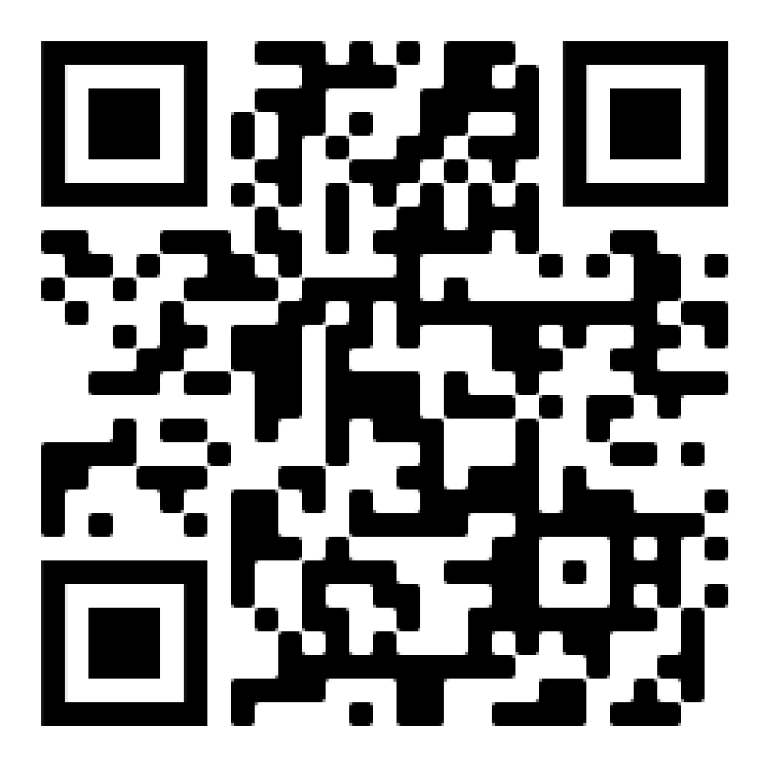
NESA Networking Event
National Eagle Scout Association
All Eagle Scouts, 21 years of age or older, are cordially invited to attend this social networking event. Come meet other Eagle Scouts and share your Scouting stories.
Date: September 22, 2022
Time: 6:30 – 8:30 pm
Cost: $10.00
Location: 674 W Center St.
West Bridgewater, MA 02379
https://scoutingevent.com/251-Eaglefellowship

Slide 42
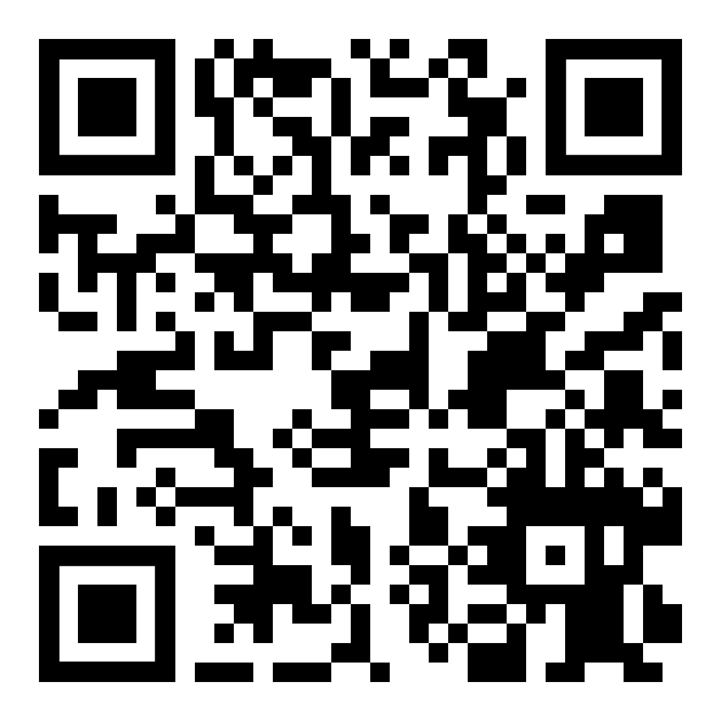
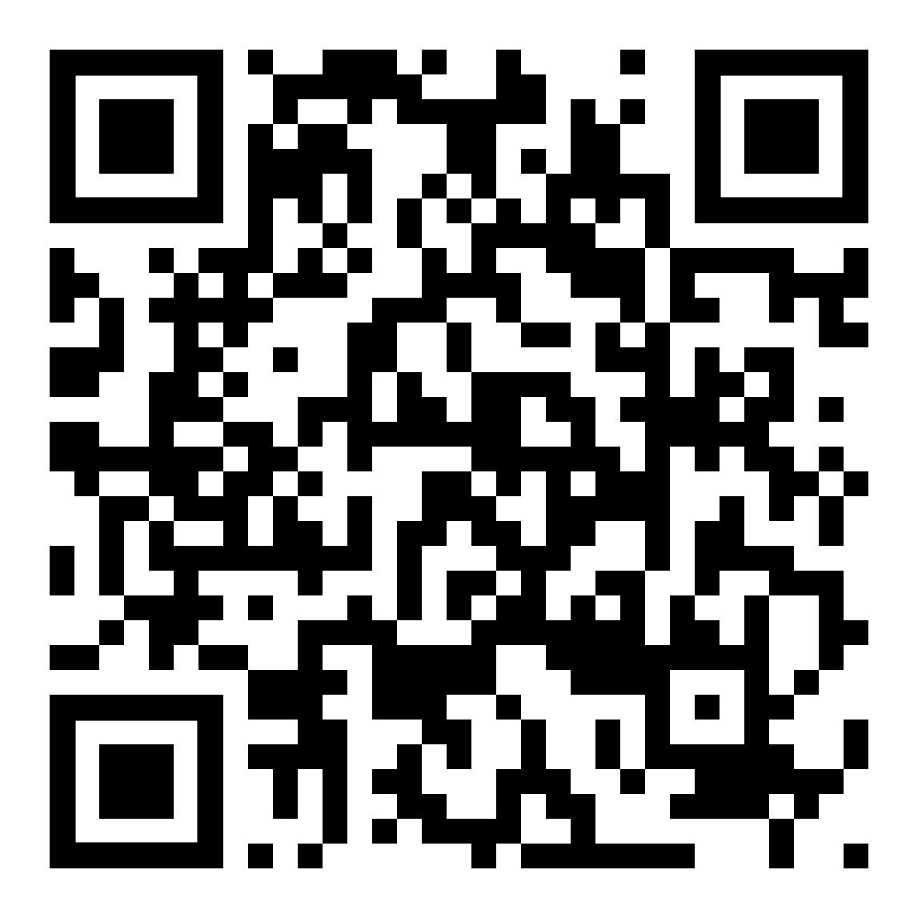
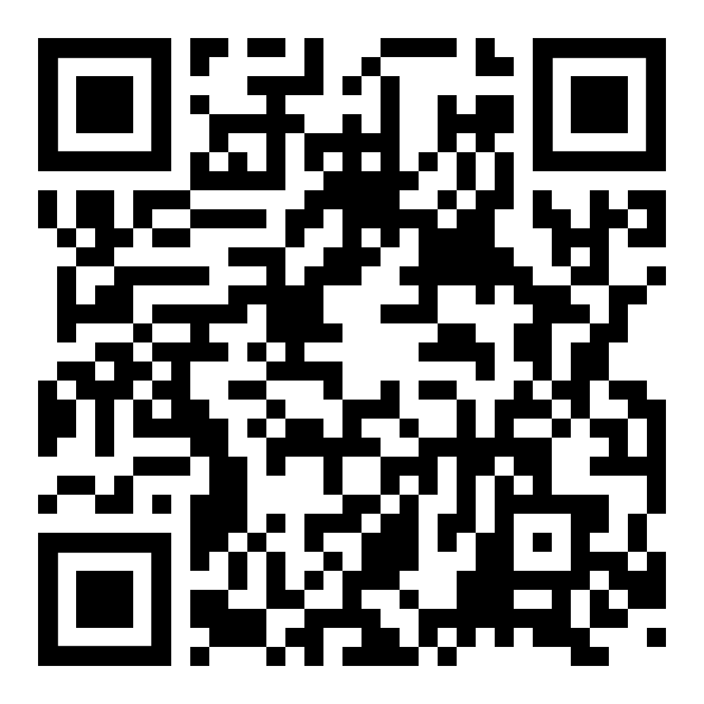
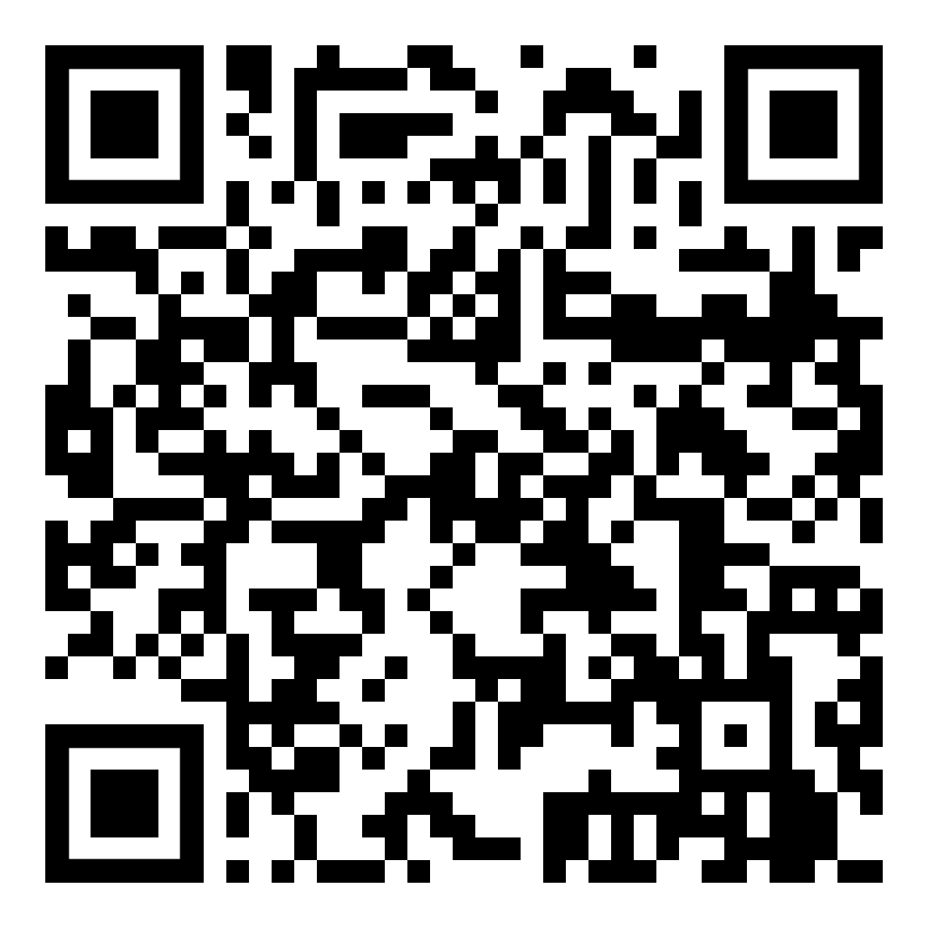
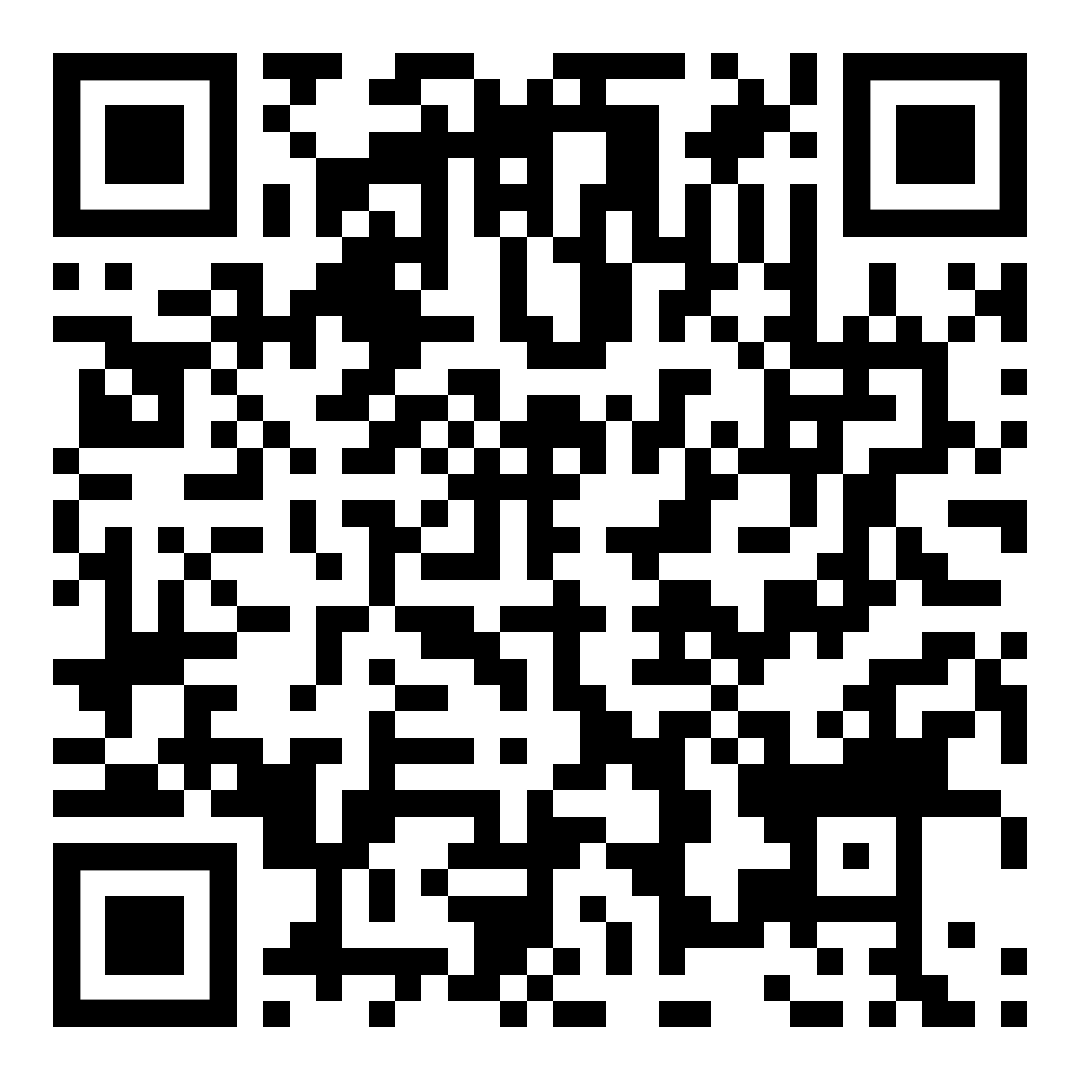
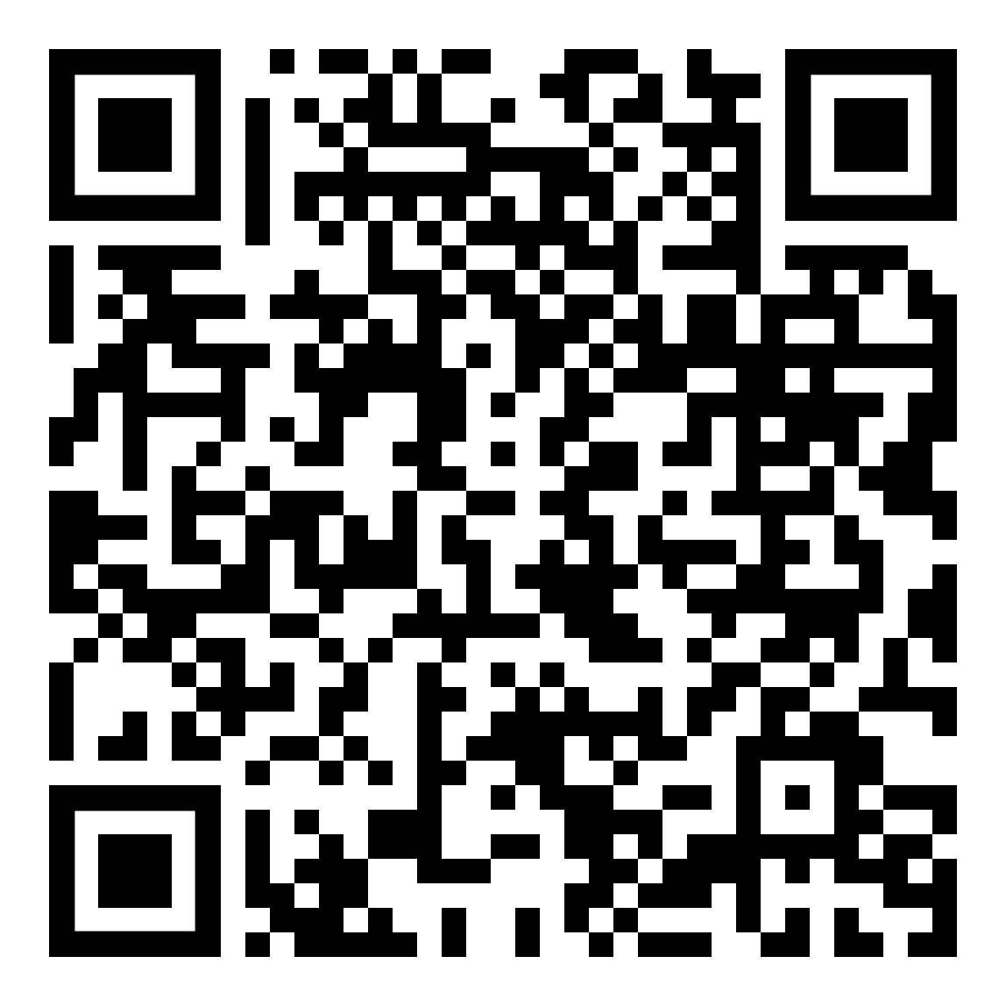

Opportunities for Success (Recorded Workshop webinars)
Invitation Manager Training
Posting Proverbs
Starting Your Unit Facebook
https://bit.ly/3yOeqtv
https://bit.ly/3o9lIDe
https://bit.ly/3cof9de
Join Scouting Day Specific
Cub Scout Recruiting Tips
https://bit.ly/3PvoQEY
https://bit.ly/3cof9de
https://bit.ly/3PkVAkM
Notes:
Information Overload!
Logo across the bottom is too large and unrelated to the content—distracting
Dashboard is a screen-grab—low resolution, so cannot be easily read in the room
Callouts all show at same time—TOO much information
White on gray, light blue on gray, nothing Bold…entire slide is nearly illegible

Slide 43
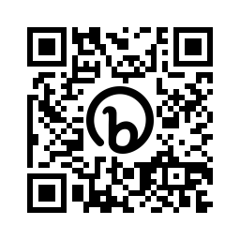
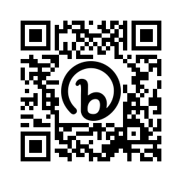
Opportunities for Success (Recorded Workshop webinars)
Unit Dues and Fees
Application Manager
https://bit.ly/3d4gWoh
https://bit.ly/3oZDjOw
Notes:
Information Overload!
Logo across the bottom is too large and unrelated to the content—distracting
Dashboard is a screen-grab—low resolution, so cannot be easily read in the room
Callouts all show at same time—TOO much information
White on gray, light blue on gray, nothing Bold…entire slide is nearly illegible

