Slide 1
Pack 000 Joining Night!
1
Notes:
*
1

Slide 2
What is Cub Scouting?
Year-Round, Family-Friendly program led by adult volunteers and designed for boys in Kindergarten through 5th grade (ages 5-10)
Involves hands on activities based on
Citizenship training
Character Development
Personal Fitness
2
Notes:
The purpose of this slide is to show age groups and the overall purpose of Cub Scouting.
*
2

Slide 3
Cub Scout Dens
Kindergarten – Lions
1st Grade – Tigers
2nd Grade – Wolves
3rd Grade – Bears
4th Grade – Webelos I
5th Grade – Webelos II
3
Notes:
The purpose of this slide is to give non-Scouting families an idea of some of what Dens are.
*
3

Slide 4
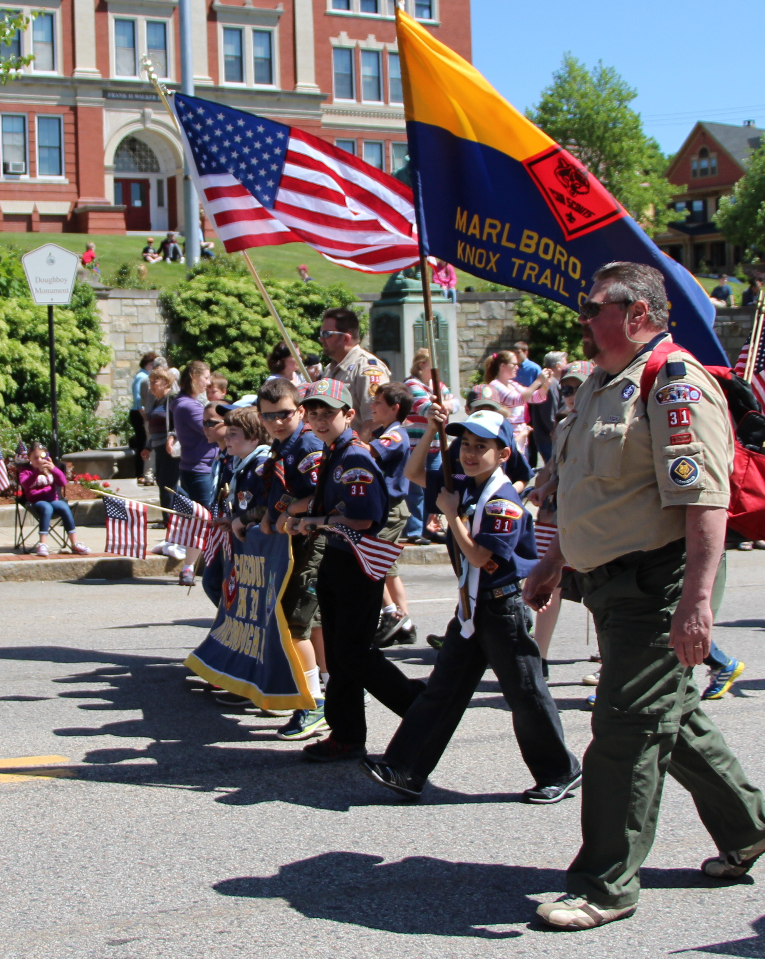
Pack 000’s Annual Events:
Parades
Pinewood Derby
Blue & Gold Banquet
Museum of Science
Pawsox Overnighter
Fishing Derby
Adventure Day Camp
And Go See It Events!
4
Notes:
Use this slide to add your major Pack events throughout the year. This is important because it shows potential Scout families how active your unit is and that you have planned your events ahead of time. This is a good time to pass out your Pack calendar.
*
4

Slide 5
Service Opportunities
Scouting for Food Drive
Church Clean-Up Day
Winter Coat Drive
Book Drive
Adopt A School Program
5
Notes:
Service is a big part of Scouting and can be a deciding factor in why families choose to get involved. This slide is for you to highlight your unit service projects for the year to give parents an idea of what your pack is all about.
*
5

Slide 6
The Cost of Scouting
Below is the pro-rated cost to register from now through December:
$24 Registration Fee
$12 Boys’ Life Magazine Subscription (age appropriate reading!)
$00 Pack Fees for materials dues
$00 Checks can be made out to: Pack 000
*Note: There will be additional costs for individual activities and for uniforms
6
Notes:
This slide is VERY important! You should have your fees figured out before your joining night so families can see what the investment is and where the fees go. It is ideal to collect all of the money at the joining night and have your unit treasurer write the Council a check for the full amount of the fees that you are turning in. Checks should be made out to the Knox Trail Council.
*
6

Slide 7
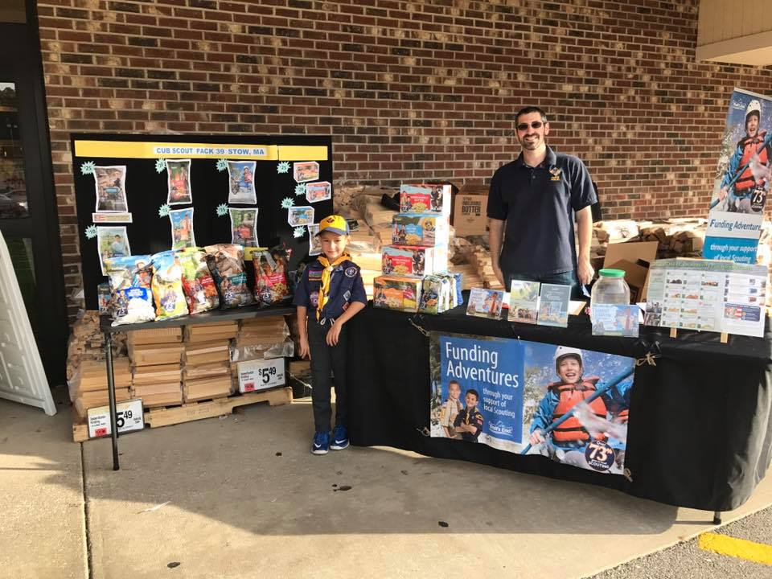
Pack Fundraising Opportunities
Fall Popcorn Sales!
Popcorn sales can help us fund our Pack’s program needs for the year and part of the revenue generated through sales helps our local Council as well!
7
Notes:
Now that you have explained the costs of Scouting you should explain any opportunities your unit has to fundraise as well! Families will be happy to know that they can help earn money for the Pack!

Slide 8
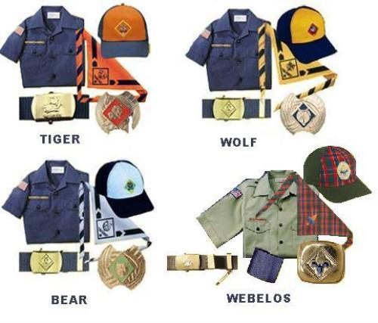
Uniforms
Additional items-Available at the Scout Shop
Handbook
Neckerchief and Slide
Uniform Shirt
Pack Numbers (000)
8
Notes:
This slide is to give families information about uniforms. Tell them what items your unit requires and/or provides. Fill in your unit numbers so they know what to purchase. This is a good time to pass out the scout shop flyer in your Joining Night crate.
*
8

Slide 9
Help Wanted
Tiger Den Leader & Assistant Den Leader
Assistant Cubmaster
Popcorn Kernel
Pack Treasurer
Pack Webmaster
9
Notes:
List the top volunteer positions that you need filled this year and give a brief description of each. Try not to list more than 3-5 positions so you don’t overwhelm your audience with needs.
*
9

Slide 10
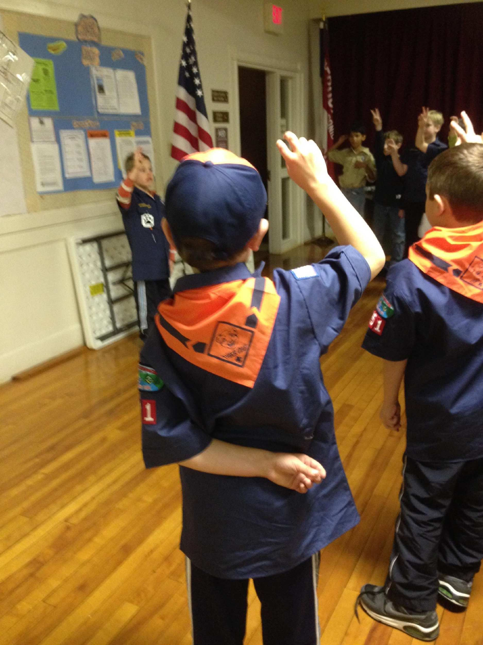
Meeting Dates
Pack Meetings
____ Day of each Month (Sept.-May) 0:00pm
Name of location
Address
Den Meetings
____ Day of each week (Sept.-May) 0:00pm
Name of location
Address
10
Notes:
Make sure everyone knows what your general meeting dates are. Don’t assume that people know where all places in your town are. Make sure to give the full title of the location and address.
*
10

Slide 11
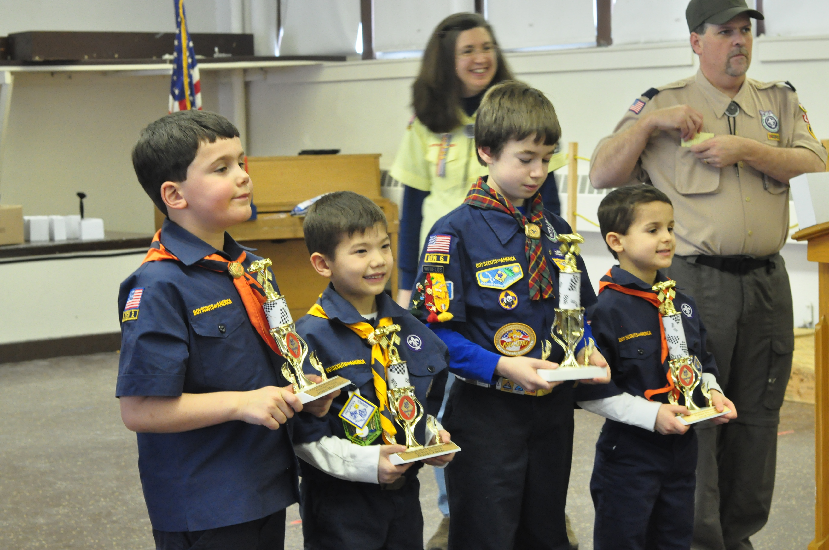
Fall Activities
Taste of Scouting
Pack Event, month date
11
Notes:
List the immediate dates of events that boys can begin to look forward to so families can start adding them to their calendars.
*
11

Slide 12
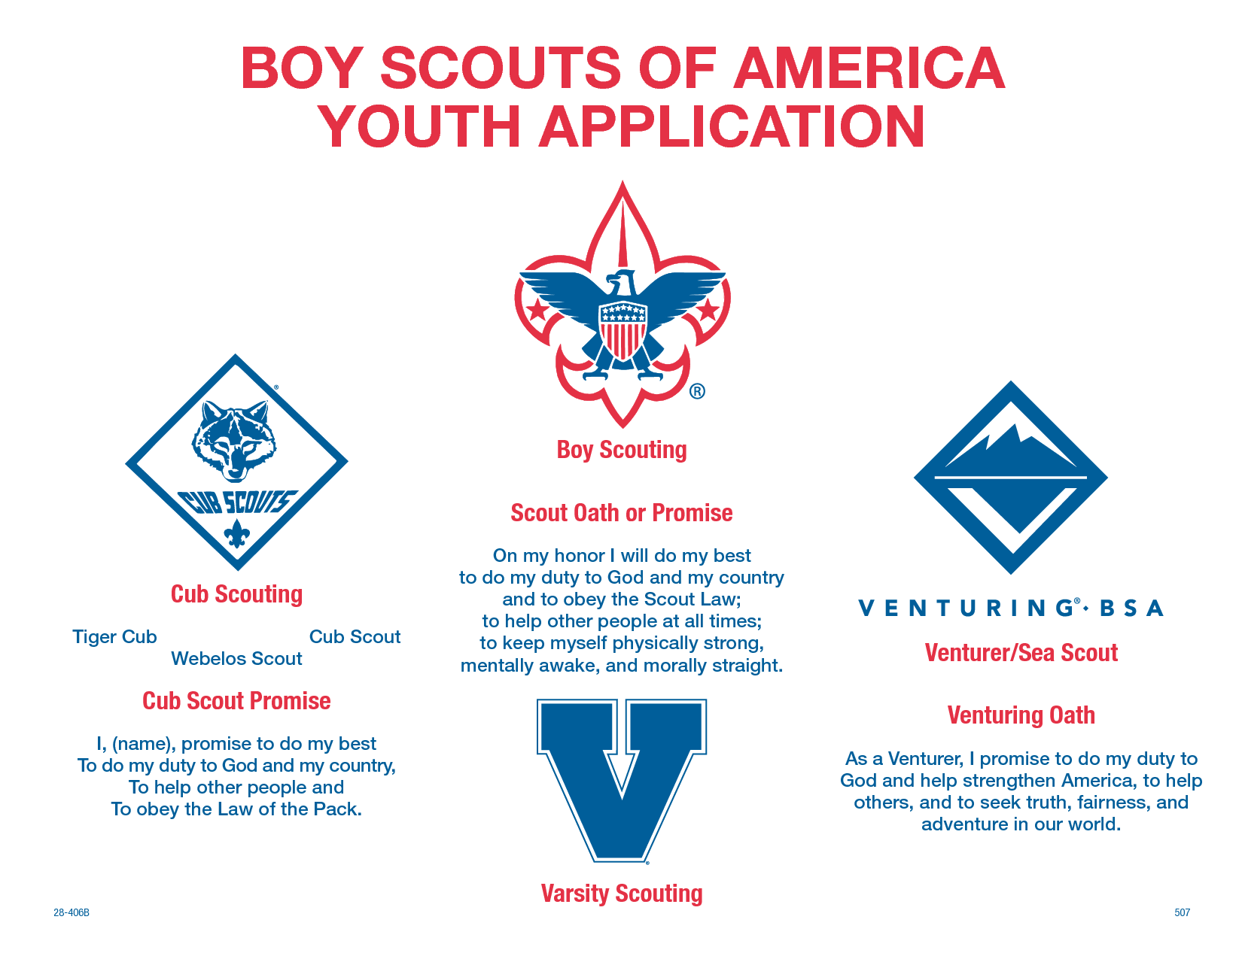
How to Register Today?
Turn in a Youth Application
$___ Joining Fee
Parent Talent Survey
12
Notes:
There is a lot of other information out there that you are going to need for the rest of your program year but you can save that for the Parent Orientation night (adult registrations, adult trainings, etc.) Tonight, focus on registering the boys so you can assign dens and obtain a parent talent survey so you can follow up individually with parents who might be a good fit for needed roles in your unit. Give them a call or e-mail them before your Parent Orientation night so you can talk to them individually about the roles that best fit them.
*
12

Slide 13
http://www.scouting.org/Home/Marketing/Downloads/PFL_Videos.aspx
13
Notes:
If you have internet and sound availability here is the link to some short video clips (less than 3 minutes) that you can show. Choose your favorite to play while families consider filling out paperwork.
*
13

Slide 14
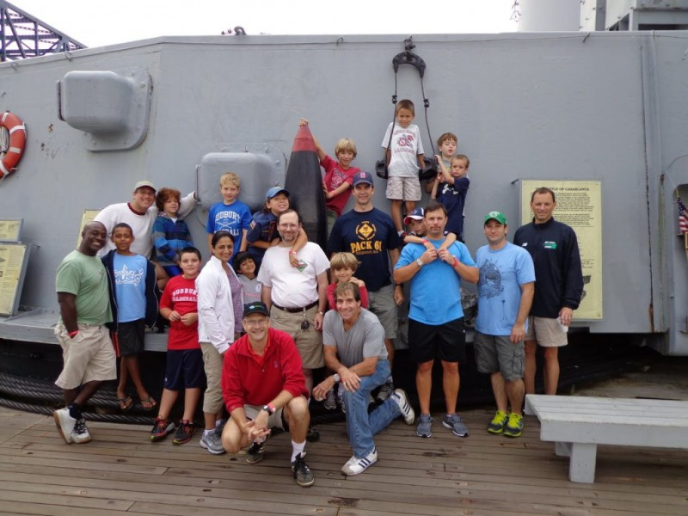
14
Notes:
For this slide you can add a picture of your pack!
*
14

